Slide 1

Awareness to Action: Understanding and Responding to Warning Signs Workshop 2
Notes:
Suggested script:
Welcome everyone (back) to Circles of Safety: Awareness to Action, and to our 2nd workshop in this series. This workshop is: Understanding and Responding to Warning Signs
Handout pre-survey
Review: - Review as necessary
(for virtual workshops) Zoom Housekeeping, asking that participants have their picture, first name, pronouns, and the agency they are representing. Share whether class will be recorded. Review chat functions
Homework announcement – will be assigned at end of each day, mostly reflective
Breakout or small groups
Website manual: www.stopitnow.org/workshop2 - Includes the table of contents, slides, handouts and resources
Option: End of day meditative debrief, noting that because this can feel like an intense topic, an opportunity to mentally debrief with a brief exercise right at the end of each day will be provided, this is similar to a meditation, just a way to bring you out of workshop/training mode and back into your day. Your participation is voluntary.
Introductions
Icebreaker recommended
Note if you be available after the workshop for any private questions, and if appropriate invite participants reach out through chat (if virtual) or email to the trainer(s) privately.

Slide 2
Learning Objectives
Learn about the scope and impact of sexual abuse.
Understand key prevention steps.
Recognize children’s healthy sexual development behaviors and how this knowledge promotes protective factors
Learn about safety planning to keep children safe from sexual harm
Identify and respond to warning signs in children, youth, and adults.
Apply prevention steps, safety planning, and supportive strategies across situations.
Practice and strengthen skills for engaging in difficult conversations about safety and sexual behaviors.
Practice and build confidence with new prevention skills.
Notes:
Suggested script:
In our last workshop we learned about the scope of child sexual abuse, and then identified some key prevention steps. We then talked about the importance of understanding children’s development as it relates to healthy sexuality and relationship, and how we can then better strengthen the relationships and situations in a child’s life. You learned about safety planning as one of these tools. And now we’re going to turn to preparing us to recognize and respond to concerns, including how to better speak up when we do have a concern. The goal is that you all will feel more confident in your ability to address concerns that come up with the children in your lives.

Slide 3
Prevention Continuum
Safe, healthy, appropriate behaviors
Unsafe, concerning, inappropriate
behaviors
Harmful,
abusive, or illegal
behaviors
Behaviors that cross boundaries, violate safety rules or policies/procedures
Notes:
Suggested script:
>ADVANCE SLIDE
Let’s continue talking about children’s behaviors in the yellow prevention continuum. We discussed behaviors that could mean a child may be being abused, and now we’re going to talk about behaviors that could mean a child is a risk to harm others.
This can include behaviors that may be typical but are becoming problematic because they cross boundaries or violate safety rules, or these could be behaviors that are not healthy, safe or developmentally appropriate.
This is often when we have the opportunity to intervene before harm happens; by paying attention to warning signs, we can protect and respond.

Slide 4


Up to 77% of reported cases of sexual abuse involve two minors.
Notes:
Suggested script:
So looking at children’s sexual behaviors that could be problematic or even harmful,
>ADVANCE SLIDE
I want to remind you first of research we shared earlier that found that up to 77% of reported cases of sexual abuse involve two youth – children and teens under the legal age of consent.
Experts agree that a key strategy in preventing child sexual abuse is to address youth’s problematic sexual behaviors that are potentially harmful and abusive – not punitively but developmentally – meaning that we approach their behaviors not with a criminal justice response necessarily, but through understanding what the youth is experiencing developmentally and tailoring our responses to support the youth to make necessary behavior changes.
It may help you to know that when a youth has sexually harmed another youth, when they receive the appropriate support – including often professional resources and healthy sexuality education – they are very unlikely to continue to engage in those harmful behaviors.

Slide 5

Youth problematic sexual behavior is sexual behavior initiated by a child or youth that is developmentally inappropriate or potentially harmful to those impacted by the behavior.
Children’s sexual behaviors are different from adults’ sexual behaviors.
Notes:
Suggested script:
But how do we know if behaviors between two youth are harmful or abusive?
Let’s start by defining youth problematic sexual behavior. Problematic sexual behavior in children and youth is sexual behavior initiated by a child or youth that is developmentally inappropriate or potentially harmful to those impacted by the behavior.
>ADVANCE SLIDE
It is important as we look at children and youth’s sexual behaviors that we remember…
>ADVANCE SLIDE
It is important for adults to view these behaviors from the child’s viewpoint and not through their own personal adult lens. For kids, sexual behaviors and sexual feelings are entirely new. They don’t have context for them other than what they’ve learned from the world around them.

Slide 6

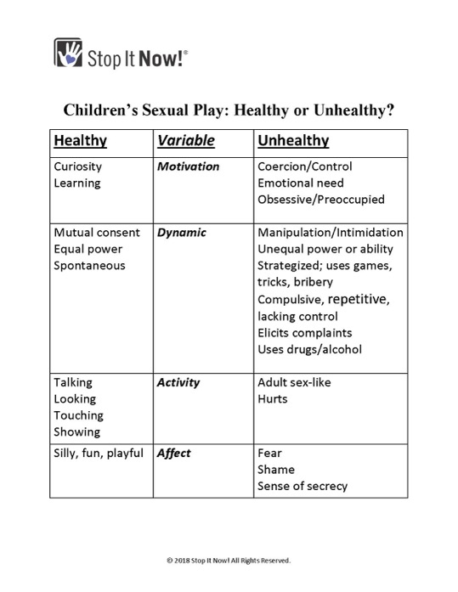
Children’s Sexual Play: Healthy or Unhealthy?
Notes:
Suggested script:
Let’s talk now about how caring adults can begin to determine whether a child or teen’s behaviors could be a cause for concern.
As we go through these next few slides, you may also want to reference the handout: Children’s Sexual Play: Healthy or Unhealthy?

Slide 7
Determining if a Behavior is Problematic
Motivation
Dynamic
Activity
Affect
Notes:
Suggested script:
When looking at a behavior or situation, there are four factors that you can consider to help you determine if the behavior is healthy or not.
These factors are motivation, dynamic, activity, and affect.

Slide 8
Determining if a Behavior is Problematic
Motivation | Why is this behavior occurring?
Dynamic | Are there power differentials? Is there any coercion or manipulation? Is the behavior spontaneous? Are kids agreeable?
Activity | Is the behavior developmentally-appropriate play or is it more mature or adult-like?
Affect | How do the children seem when they are caught engaging in the behavior? How do they respond? Are they playful or worried or afraid? Are they defensive or sneaky?
Notes:
Suggested script:
So first, we look at the motivation. Why is the behavior occurring? We may not always know what the answer is – the child may not even know why they are doing what they are doing, but we can try to figure it out by asking children more about the particular behavior, like where they learned the behavior from and have they seen anyone else behaving this way.
What we discover can help us figure out whether the kids were mimicking something they saw previously or if it was it to explore sexual feelings or relationships. When possible, understanding more about the behavior – where a youth is coming from, where they got the idea from, etc – is helpful in determining how problematic a sexual behavior is. And even if we don’t know the motivation, we still respond appropriately and protectively.
>ADVANCE SLIDE
We also look at the dynamic. This means we look at the youth involved themselves, and we look at how consent was demonstrated – assessing if the behavior is mutual, meaning do both children willingly participate in the play or behavior? Are they both agreeable to this type of play? Or is there coercion, manipulation, bribery or threats. Is one youth somehow forcing another to participate in the behavior? While children cannot consent legally to any sexual activity, is there a sense that one youth wanted to engage in this behavior, while the other one did not? This would be concerning.
And as we observe behaviors between youth, we identify any power differences such as differences in age, size, learning abilities, or cognitive abilities of the children involved. If one child seems to have power in any way over another child, then this could be a factor that changes how we assess the situation.
Additionally, it can to helpful to try to determine whether the behavior is more spontaneous or perhaps impulsive, and we note whether this behavior has occurred more than once or twice – so are we seeing a behavior that continues even after a youth has been redirected and given information about safe behaviors?
>ADVANCE SLIDE
We also need to look at the type of activity.
Is it playful and generally considered a normal type of activity for this age group—-maybe like playing house or school?
Sometimes an activity, like a game of “spin the bottle” with 12 year-olds, may be considered generally developmentally appropriate and expected (while still causing parents to pause!). Of course, we still intervene with information about safe behaviors and emphasizing safety rules like keeping clothes on when playing with others, but this type of activity doesn’t directly reflect a youth who is struggling with problematic sexual behaviors alone if the game was mutual between friends.
Sexual behaviors and activity raises flags when it is more adult-like; when children are behaving – even in play – in a way that is sexually mature and demonstrates knowledge or interest in sexual behaviors that are more often a part of an adult’s sexual life.
When it comes to teenagers, their activity may look very adult-like. So this is not our best clue with this age group. However, we can pay attention when a teen seems to have advanced sexual knowledge and engages in more extreme sexual activity. Sexual behaviors that include aggressiveness would be very concerning. And if drugs and/or alcohol are involved, this would of course be unsafe.
>ADVANCE SLIDE
Finally, we need to look at affect, or the children’s emotions/actions when the activity is discovered.
Do the children involved seem slightly embarrassed, but overall happy and playful? This could be the marker for healthy play. Or do they seem worried or afraid that they were caught?
Does it seem like they were behaving in a sneaky way, like they knew they were doing something that was against the rules? When they are caught, are they reacting defensively?
If any youth seems like they are uncomfortable with what is going on, we should pay attention to that.
Again, some of these markers may be less helpful when you’re noticing concerns with a teenager’s behaviors, as they might present as sneaky or defensive regardless of whether behaviors are typical or concerning. But, by being an askable and available adult it is possible that a teenager will talk about how they feel when they are exploring relationships and sexuality.

Slide 9
Healthy or Unhealthy?
A group of 5-year-olds were playing together. The mom of one of the children found them together and two of the kids were partially undressed.
The mom was worried but when she asked the kids what they were doing, one of them said they were making a movie and some of kids were changing their costumes.
Notes:
Suggested script:
Let’s look at an example situation.
A group of 5-year-olds were playing together. The mom of one of the children found them together and two of the kids were partially undressed.
Is this a situation where you should be concerned? Is this in the green, yellow, or red prevention level?
>ADVANCE SLIDE
The mom was worried, but when she asked the kids what they were doing, one of them said they were making a movie and some of kids were changing their costumes.

Slide 10
Determining if a Behavior is Problematic
Motivation | The reason offered by the kids was reasonable and age appropriate indicating this is likely a green, normal, healthy behavior.
Dynamic | There were no power differences in the children and no apparent coercion.
Activity | The activity was playful and was a normal, developmentally appropriate behavior for 5-year olds.
Affect | All of the kids seemed to be happily playing together.
Notes:
Suggested script:
So now let’s go through each of the variables.
First, looking at motivation.. The reason offered by the kids was reasonable and age appropriate – they were playing, and in the context, this behavior made sense.
>ADVANCE SLIDE
Next – looking at the dynamic between these children, we might ask: are there large differences in age, size, or development?
And in this scenario, no - all the kids were around the same age, and were willing and happy to play with no one appearing to be forced to play.
>ADVANCE SLIDE
And we ask: Is this behavior developmentally appropriate? Is it playful?
In this situation, the activity was indeed playful and was a normal, developmentally appropriate behavior for 5-year olds.
>ADVANCE SLIDE
And finally - How did the children react when discovered?
Looking at the kids’ affect in this situation: all of them seemed to be cooperatively playing together. No one seems worried or ashamed, they seem to be enjoying their play together.

Slide 11

Safe, healthy, developmentally appropriate behaviors
Reinforce safety plan
RESPOND &
REINFORCE
Educate children
Monitor and supervise
Notes:
Suggested script:
So if you do determine that a youth’s sexual behaviors is part of age-appropriate, expected play, it may seem like you can ignore these behaviors, and it is easy to just think, “well, kids will be kids”. But, even with behaviors in the green prevention continuum, you have an opportunity to act proactively and respond and reinforce. With these sexual behaviors that are healthy and developmentally expected, there are three things we’ve reviewed that you can do:
>ADVANCE SLIDE
You can reinforce your family’s safety plan, including information and rules about safe boundaries, respect, and privacy. You can use the opportunity to reinforce the safety rules just as you would with other family rules: like telling the truth, or looking both ways before you cross the street. For this example, we remind the kids that when we play, we keep clothes on and the places we cover with a bathing suit are private.
>ADVANCE SLIDE
You also want to provide children and teens with age-appropriate and accurate information and answer questions in a way that makes sense for their age and development. You don’t want to shame them. Instead, you want to teach them how to behave appropriately while they are learning about their bodies and relationships.
>ADVANCE SLIDE
And, you want to monitor their ongoing behavior by staying engaged, providing supervision, and redirecting their behavior when needed.

Slide 12
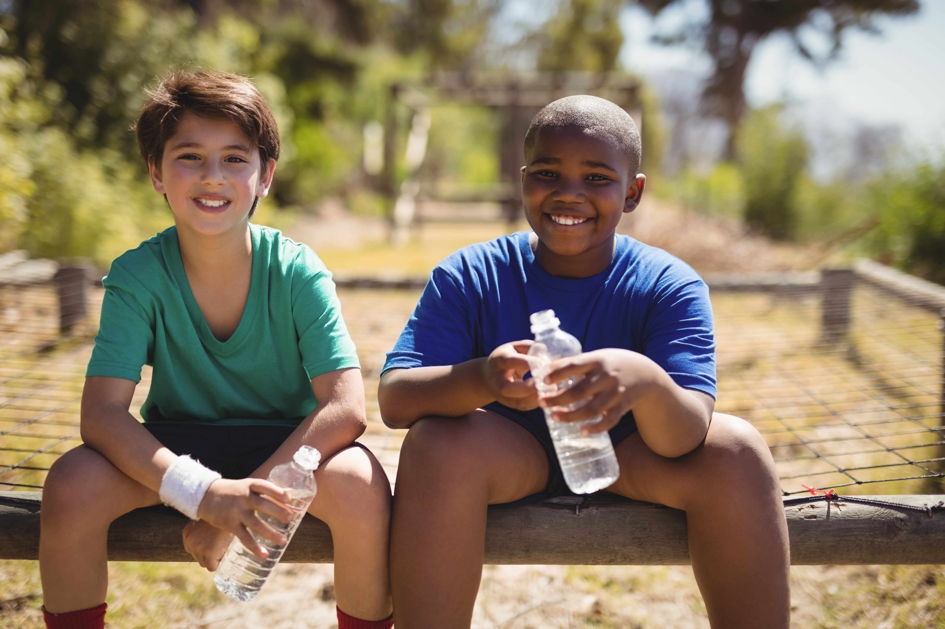
Activity
Select the action steps that would be appropriate based on the following situation:
Your 6 year old and their 6 year old friend were found playing together in the living room. One had their pants down and was looking at the other child’s penis. When asked what they were doing they said they were playing doctor.
What should you do?
Notes:
Optional for trainers
Suggested script:
Activity: Let participants know that you’re going to be doing a poll/quiz (in Zoom/on paper).
Instructions: You’re going to read out a short scenario that’s also up on their screen. Then you’ll give them a number of statements – they should select yes or no for each action step based on the situation provided. Yes means you should take that step. No means you should not take that step. Discuss throughout.
Situation: Your 6 year old and their 6 year old friend were found playing together in the living room. One had their pants down and was looking at the other child’s penis. When asked what they were doing they said they were playing doctor. What should you do?
Multiple choice questions:
1. Ignore the situation, kids will be kids
Answer: No.
Discussion point: Even in green situations that involve developmentally appropriate play, we want to intervene.
2. Talk to one of the kids about boundaries, but don’t mention the situation directly, you don’t want to embarrass them
Answer: No.
Discussion point: It’s important to talk with both kids clearly about the situation, as otherwise they won’t understand what you’re asking. Being vague isn’t as helpful as sharing directly what is okay and what’s not.
3. Check in with both kids and clarify boundaries; this wasn’t safe, but there are safer ways to play
Answer: Yes.
Discussion point: Similar to the previous question – we want to make sure kids know that even though it’s normal to be curious, we keep clothes on when we play. This may be a great time to review your safety planning rules and consider what else you want to add.
4. Talk to the other child’s parents to make sure everyone is in the loop
Answer: Yes.
Discussion point: This other parent will want to follow up with their child and ensure they’re okay, that they know the rules, and that they have adequate healthy sexual development information if they’re curious. This can also be a good way for parents to join together on a safety plan.
5. Continue to let these kids play together, and make sure supervision is adequate
Answer: Yes.
Discussion point: As long as the two children want to play together and the caregivers can watch these kids when they’re playing, it’s okay for them to continue being friends. One incident like this doesn’t have to mean that parents break up a friendship, but special attention should be paid to any child who continues to cross boundaries after a game like this, tries to sneak off without supervision, or has any big emotions afterwards (crying, shame, fear, etc.).
6. Talk about safety rules whenever your child goes to play at another child’s house, or when another child comes over to play
Answer: Yes.
Discussion point: Talking about safety planning before playdates, visits to relatives and any other time a youth may be interacting with adults or kids is a great way to normalize expectations and remind a child of what to do if they do have any concerns.
7. Share age-appropriate healthy sexuality information with your child
Answer: Yes.
Discussion point: Kids are curious about their bodies, and now is a great time to learn more about the questions your child has about their body. Making sure you’re an “askable adult” is an important part of prevention.

Slide 13

Why Children/Youth Engage in Sexual Behaviors
Curiosity
Misunderstanding about bodies and boundaries
Life stressors
Exposure to sexual content
Behavior problems
Notes:
Suggested script:
Now let’s discuss why children and youth might engage in sexual behaviors.
Children’s sexual behaviors with another child or youth may happen for a number of reasons.
>ADVANCE SLIDE
They may behave in a sexual way due to curiosity.
Having a lack of information about bodies and sexuality can lead to behaviors that are not safe or healthy. If children are not given age-appropriate information about their body and how it functions, they will try to find that information in other ways. Sometimes that may involve behaving sexually with another child.
>ADVANCE SLIDE
They might have misunderstandings about bodies and boundaries.
Children with cognitive or developmental differences, or even social skill deficits may misinterpret what type of play is okay, or misinterpret another child’s reaction. They may not understand when another child wants to stop playing. Additionally, appropriate curiosity can turn into harmful play because they see much younger children as their peers, instead of kids their same age.
>ADVANCE SLIDE
Youth sexual behaviors can even occur due to another life stress, like divorce, a death in the family, or a big change like moving or starting at a new school.
Children’s behaviors are often a way they communicate to us that something is not right.
>ADVANCE SLIDE
These behaviors can also come up when youth have been exposed to sexual content either intentionally or accidentally.
Children respond to what they see and hear. A child could be reacting to something they heard on the bus, in school, in a video, on tv, online, or in music. Kids will often mimic what they observe.
>ADVANCE SLIDE
Impulse control disorders or other behavioral concerns can also contribute to sexual behaviors. Additionally, mental health issues in kids– such as depression, anxiety and other challenges—-may influence their behaviors.
Regardless of why, when a child behaves sexually with another child it doesn't mean they are "bad" or "broken." It does means that they need help and support.
Children don’t fully understand sexual behaviors, even if they know some basics about sex and development. They can't grasp the full impact their actions might have on others because they don't see things the way adults do.

Slide 14

Why Children/Youth Engage in Sexual Behaviors
A child or youth’s sexual behavior may be a reaction to their own abuse.
A youth may be struggling with sexual thoughts and feelings about younger children.
A child or youth may struggle with mental health conditions which can influence their behaviors
Notes:
Suggested script:
And yes, a child or teen may engage in problematic sexual behavior because of their own experience of abuse.
But it’s important to understand that not every child who has been sexually abused will sexually abuse another person. Not every survivor goes on to be an adult who abuses children – this is very important that we are very clear on this. And at the same time, the experience of being sexually abused – and particularly when there has been inadequate support, counseling, and safety is still a question, then the risk that that child might engage in unhealthy and even harmful sexual behaviors increases.
We also need to consider that a youth could be struggling with their own sexual thoughts and feelings about younger children. Sometimes youth with these thoughts and feelings may begin to cross boundaries or engage in harmful or abusive behaviors with younger children. It is important in these situations to provide support and help to these youth. Help is out there, and effective treatment is available which can prevent further problematic sexual behaviors.
Children may also struggle with mental health disorders that influence they play or interact with peers, which can include engaging in sexual behaviors that are unsafe or problematic.

Slide 15
Warning Signs of Youth Causing Sexual Harm
Confused about social rules and interactions | Insists on physical contact/alone time with child Age-appropriate sexual behaviors in inappropriate settings Spends time with much younger children
Anxious, depressed, needs help | Drugs and/or alcohol involved History of violence, own abuse
Impulsively sexual or aggressive | Behavior elicits complaints/continues after limits set Uses threats and coercion
Notes:
Suggested script:
Let’s talk now about these warning signs in children that may indicate that a child or teen could harm another child. In many ways, they’re not so different from the previous warning signs. Any youth who is experiencing any type of distress, can actually be at risk for causing other children harm – like through anger outbursts, bullying, and so on. And as with our other warning signs, a single sign or two does not at all mean that a youth is causing sexual harm to another child. But these warning signs definitely mean that adults need to pay attention and respond to these behaviors with support and prioritize everyone’s safety.
On the left, descriptions of these signs, with more specific behaviors on your right.
Handout: Tip Sheet: Signs That a Child or Teen May Be At Risk to Harm Another Child
Review the Handout with the following notes:
Confused about social rules and interactions – this may be a child who misreads social situations, seems awkward with same aged peers. Perhaps this child struggles with learning public vs. private rules, and may act impulsively to get need met, even if not appropriate. May seem overly “touchy” – perhaps with just one of two others.
Anxious, depressed or seeming to need help – children who have not been offered healing resources and support if they’ve experienced trauma are at risk for engaging in behaviors that are often inappropriate, immature or even harmful to others. These children may even seem to create opportunities where sexual issues have to be brought up
Impulsively sexual or aggressive – may use violence with sexual overtones

Slide 16
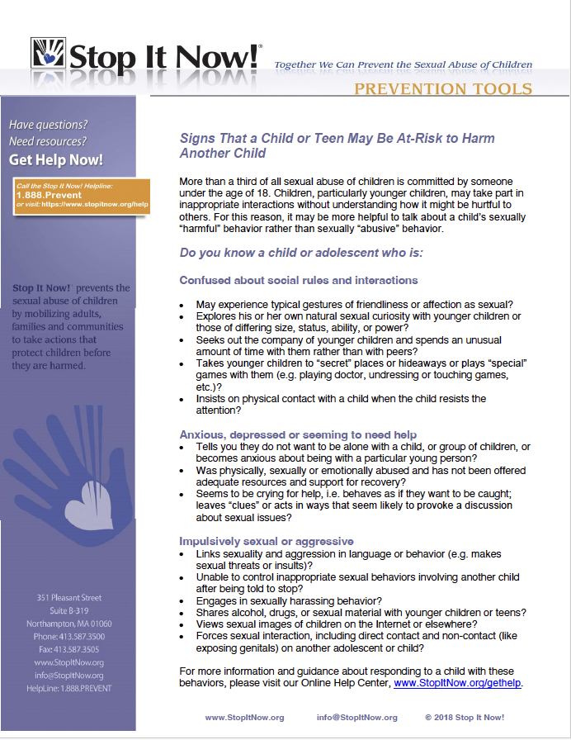
Tipsheet:
Signs A Child Is At-Risk to Harm Another Child
Notes:
Suggested script:
Let’s look at some of these behaviors more specifically - the yellow prevention level is broad – from early and minor boundary violations that have not yet caused harm to another youth, to behaviors that are crossing many boundaries, making others uncomfortable, and while not necessarily abusive these behaviors may result in another child experiencing harm.

Slide 17

Concerning Behaviors
Use of explicit sexual language
Knowledge of mature sexual activities
Behavior elicits complaints
Insists on physical contact
Ignores safety rules
Age-appropriate behaviors in inappropriate settings
Behavior continues after limits are set
Notes:
Suggested script:
Some examples include:
Children - especially younger children - who use explicit sexual and mature language
Children who seem to be aware of more adult-like sexual behaviors and situations is something to pay attention to
And when their sexual behavior makes others uncomfortable - and the child ignores personal boundaries and elicits complaints from others – this is a warning sign
Also when a child or youth continually attempts to make physical contact with another child, even when either that child or an adult has redirected them
Or when they purposefully break safety rules – such showing another child sexual images
Also, when a child displays age-appropriate behaviors but in inappropriate settings this may also be concerning. An example of this would be a school aged child touching their privates or masturbating in front of others or in public.
And when a child or youth has been reminded about safety rules, and yet they still engage in behaviors that break these rules – we recognize this as a warning sign

Slide 18
Determining if a Behavior is Problematic
A 12 year-old continually grabs their 6 year old sibling in hugs and walks in on them when they are changing.
Both parents and the
6 year old have told the 12 year old to stop, but the behavior continues.
Notes:
Suggested script:
Let’s look at another scenario now: a 12-year-old continually grabs their 6-year-old sibling in hugs and walks in on them when they are changing.
And both parents and these children have told the 12 year old to stop, but the behavior continues despite redirection. The 12 y .o. is ignoring personal space, the request of others and is ignoring safety rules and boundaries in both of these behaviors.

Slide 19
Determining if a Behavior is Problematic
Motivation | We need to understand the motivation: is this curiosity, an attraction, a problem with impulse control, difficulty understanding boundaries?
Dynamic | There is a significant age difference here and a power imbalance.
Activity | No consent, the behavior is not mutual, and it is crossing boundaries
Affect | The behavior is eliciting complaints and has prompted requests for the behavior to stop, which have been unsuccessful.
Notes:
Suggested script:
We can assess this situation using this framework that we used earlier.
First, motivation…We need to understand the motivation: is this curiosity, an attraction, a problem with impulse control or recognizing boundaries? Remember – we may not always understand the motivation and in this case, it could be for any of these reasons. But we do know that the behavior is not responding to requests for it to stop.
>ADVANCE SLIDE
Then we look at the dynamics. In this situation there is a significant age difference here and a power imbalance, as an older sibling is most often the one with more power and influence.
>ADVANCE SLIDE
Looking at the characteristics of the activity, the younger child was not consenting to the behavior – so the activity is not a mutual one.
>ADVANCE SLIDE
And finally, we look at affect – the feelings behind this behavior – which is eliciting complaints and requests for the behavior to stop.
This information now provides clear direction – we need to intervene to stop the behavior, as it has become a warning sign that the behavior – and situation – is not safe and escalate and become harmful.

Slide 20

Unsafe, concerning,
inappropriate behaviors
Trust yourself
Involve others
RESPOND &
PROTECT
Plan for safety
Take action
Notes:
Suggested script:
Knowing that a situation requires a response doesn’t always make it easy to know what to do.
>ADVANCE SLIDE
Let’s start with the importance of first trusting yourself – trusting that your concern is valid.
It’s natural to want to explain away behavior that is concerning, or to rationalize the behavior with thoughts like “children will be children” – no one likes to think of children possibly engaging in sexual problematic behaviors, but trusting ourselves, our observations and our instincts is how we stay actively involved in keeping kids safe.
>ADVANCE SLIDE
And you don’t have to take the next steps alone - involve other people..
This may mean talking to another adult who knows this child: other parents, coaches, relatives, or other involved adults you trust.
You might want to see if you can discover if anyone else has seen these behaviors before in this child, and is concerned? Is anyone else noticing warning signs?
If you are a parent, involving your pediatrician or other medical care professionals might be helpful.
Remember that we also want to respect the privacy of the youth, so we only want to share personal information with those adults in a position to keep the child and others safe and to help support the children.
>ADVANCE SLIDE
And you should evaluate and reinforce your safety planning specific to children’s behaviors – making sure that the youth in question is clear on the rules and expectations, while offering support if they are struggling to follow the rules.
You can let the youth know that you want them to be safe, to grow up into a safe adult and that their behaviors are putting others at risk as well as themselves – and that it is your job to help them with their behaviors – and that may mean asking a professional, like a counselor to help. Most importantly, we don’t want this young person, this child to be shamed or made to feel like a monster – more importantly is to let them know that they are loved and that with help, they can make safer decisions about their behaviors.
It’s possible that further evaluation of the child’s behaviors may indicate the need for more education, professional support or other resources. Again, you don’t need to figure it all out alone.
>ADVANCE SLIDE
Also make sure you communicate your concerns to others in position of supervising the child – and let them know what the safety plan is and to emphasize the importance of vigilant supervision.
I also want to note that if there are persistent warning signs in a child’s sexual behaviors – especially when they are creating an at-risk environment for other youth, contacting your local child protection service is recommended. We want to help make sure that children are getting all the help they need, and that everything that can be done to provide resources to the children involved is being done.
I also want to note that in everything we do, we also make sure that all children involved know that we – the adults - are there to support them, keep them safe and that they are all equally loved and worthwhile.

Slide 21
Talking with Youth about Warning Signs
Stay calm, don’t shame or label
Talk about behaviors – not intent
Refer to safety plans and rules
Redirect and talk about alternatives
Help kids build communication skills
Let them know that adults are responsible for helping them and their environment stay safe
Notes:
Suggested script:
Talking to the child or teen when there are warning signs in their behavior is also part of our response, it is part of safety planning.
When we intervene early – like when we see a child hugging another child too tightly – we can help them learn to read the other child’s body cues and give them alternatives so that next time they are more likely to understand healthy limits. Warning signs are clues we need to provide additional help and support.
So let’s quickly go over some communication tips that can help you have a conversation like this with a youth. We may be frustrated or even angry with a child’s boundary-crossing behaviors, but it’s important to talk with this child or youth about their behaviors calmly and supportively. We don’t want to shame or label them, or assume why they did what they did, but instead clearly talk about the behaviors – what’s okay and what’s not. We need to talk about safety rules and share alternatives if appropriate. We may also want to help them develop empathy about how to know what another person may be feeling – as all this may help them make healthier decisions in the future. And of course we want them to know that we are on their side, and that our goal is for them to have healthy safe relationships.
Remember – we have to look at kids’ behaviors through different lens too, not just through our adult eyes. This can even mean asking them – where did you get that idea from? Or, what questions do you have about X?
This conversation could look something like “Hey Aiden, I wanted to check-in with you because it’s my responsibility to keep you safe. I saw that you tried to force a hug on Liam and they were squirming to get away. And they told me that you also walked in on them when they were changing again. I want to remind you that these types of behaviors – hugging someone without their consent and walking in on a person in their private moments (like bathing, using the bathroom. changing, etc.) - are against our safety rules, so that isn’t okay. You can tell that he wanted you to stop by also looking at his face – he looked frustrated and was trying to push you away. There are other ways you can play with someone or give them affection even if they don’t want to be touched; we can brainstorm some ideas together. And if you’re curious about bodies, I can share a good book with you.”
The same applies for teens. If you notice an uncomfortable interaction, take the youth aside and let them know that this isn't ok. Since they likely have more knowledge and language comprehension than a younger child, you might use words like "consent" and "body autonomy" to describe the types of boundaries which are important to respect. But really, talking to teens about boundaries is the same as checking in with a younger child. Teens are still learning, growing, and figuring out what is and isn't okay. They need guidance, and can benefit from knowing that there's someone in their life they can trust with help in understanding these important interpersonal issues.
Suggested question for increasing conversations (optional): Does anyone want to share about a situation that they’ve been in when they talked with a youth - what was successful and/or what was challenging?

Slide 22

Activity
Select the action steps that would be appropriate based on the following situation:
Your 15 year old nephew told your 12 year old son that he can show him naked pictures online if he’s interested. Your son said “ew, no.” Your nephew brought it up again the next time they saw each other. After this your son came to you with this information. What should you do? What should you do?
Notes:
Optional
Suggested script:
Activity: Let participants know that you’re going to be doing a poll/quiz (in Zoom/on paper).
Instructions: You’re going to read out a short scenario that’s also up on their screen. Then you’ll give them a number of statements – they should select yes or no for each action step based on the situation provided. Yes means you should take that step. No means you should not take that step.
Situation: Your 15 year old nephew told your 12 year old son that he can show him naked pictures online if he’s interested. Your son said “ew no.” Your nephew brought it up again the next time they saw each other. After this your son came to you with this information. What should you do?
Multiple choice questions:
1. Keep this to yourself, no need to share with the other parent because the youth seems fine
Answer: No.
Discussion point: Even if a child seems fine, it’s important to follow up with the other parent. This ensures they’re able to monitor them for any changes in their behavior, answer questions and provide them support as needed.
2. Yell at your child, they really shouldn’t have done that!
Answer: No.
Discussion point: Children and teens who are crossing boundaries still need care and support. Shame doesn’t help a youth learn more, or feel comfortable asking questions if they’re confused or scared. Provide ongoing love to your child, and ensure them that you’re there to help them make safe decisions. Stay calm, and let kids know what is not okay – and talk about consequences if warranted.
3. Check in with your child and make sure they know you love them. Ask them, “where did you get the idea for this?”
Answer: Yes.
Discussion point: Providing ongoing love and care is important. Leading questions that only have a yes/no answer (like “Did your older cousin show you pornography?” aren’t as helpful as open-ended ones, which can sometimes helps a parent learn where a child is learning a new behavior from so they can take action.
4. Review the warning signs tip sheet and see if there are any other concerns you’ve noticed in the way your child behaves with other kids
Answer: Yes.
Discussion point: If a child or teen is doing something that is pushing boundaries, we want to learn more and see if there is anything else that needs to be attended to. Warning signs – like the one here – are a call to action, as kids sometimes can’t clearly describe when they’re confused or have a question, but their behaviors may be showing that something is going on that needs more attention.
5. If you see other concerns, consider seeking out a therapist for your child
Answer: Yes.
Discussion point: A therapist can help support a youth, help them learn safe behaviors, and help them with empathy and coping skills. Therapy can also be great for everyday concerns like in a child’s relationships or at school.
6. Share age-appropriate healthy sexuality information with your child and learn more about how they’re interacting online.
Answer: Yes.
Discussion point: Sometimes youth are accidentally or intentionally exposed to pornography or inappropriate situations online, which can be confusing for them. Being proactive and seeing how your child is using technology is another great way to be a protective adult.
7. Review safety planning info with your kid and make sure supervision is active and engaged when your child is playing with other kids.
Answer: Yes.
Discussion point: New rules don’t have to be punishment, but can be another way you support your child’s healthy growth. Right now, it would be important that this child is not left alone around other kids, or to babysit when they’re having trouble making safe decisions.

Slide 23
Safe, healthy, appropriate behaviors
Unsafe, concerning, inappropriate
behaviors
Harmful,
abusive, or illegal
behaviors
System Response & Safety Planning
Notes:
Suggested script:
>ADVANCE SLIDE
Next, let’s look at sexual behaviors that are harmful or sexually abusive behaviors and in some cases illegal – these would be considered our red level behaviors.

Slide 24

Abusive Behaviors
Uses force, aggression, bribes, coercion or manipulation paired with sexual behavior
Mature sexual behavior between young children or between an older youth and a younger child
Does not respect another child’s “no” or elicits complaints from another child when playing sexual games
Shows vulnerable (younger) child explicit sexual images, videos or content, or offers alcohol or drugs
Views harmful and/or illegal online content
Harmful
Notes:
Suggested script:
>ADVANCE SLIDE
So first we identify whether a child or youth uses force, aggression, bribes, or coercion, tricks, or manipulation to make someone do something sexually – this is harmful, and depending on other factors may also be abusive
>ADVANCE SLIDE
Also, when a young child engages in mature or adult-like sexual behavior with a similar-aged child or when an older youth does so with a younger child.
>ADVANCE SLIDE
Behaviors are also abusive when a child or teen ignores another child’s “no” and continues behaving sexually toward that child, even if they are playing a game.
>ADVANCE SLIDE
Also showing another youth, and particularly a younger child, sexual images or content, or offering them alcohol or drugs, is abusive.
>ADVANCE SLIDE
And intentionally viewing illegal material or child sexual abuse material online is illegal and is child sexual abuse – as it is with adults.

Slide 25

Sexuality and Technology
Youth may:
Explore sex or sexual identity
Find, view, or produce sexual content
View pornography
View child sexual abuse images
Extort peers for sexual images or money
Notes:
Suggested script:
I want to briefly share also some information regarding sexuality and technology, as we think about youth's own behaviors that can be unsafe to others.
Children and youth are often at risk of being abused and exploited sexually online as we talked about. But children’s and teen’s own behaviors can be harmful and abusive online, as well. Unfortunately, there are many opportunities to behave in ways which are inappropriate or unsafe online.
>ADVANCE SLIDE
Some youth may explore sex or their sexual identity online and search for things they are curious about, like sex, bodies, and relationships. We see a lot of this in sexting behaviors. Youth using their devices to test the water with sending sexualized content and images of themselves – mostly designed to build intimacy or flirt.
Some may find and view or even produce sexual content. Youth may look at pornography or child sexual abuse material which is illegal content of children being sexually abused. And some youth may take and send sexual pictures of themselves to someone they like or whose attention they want. They may also receive sexual pictures from their peers.
And some youth may extort peers for sexual images or money.
There are many negative consequences to such behaviors, and kids rarely heed warnings that pictures can be shared with others or that things they do online can harm others or end up negatively impacting them.
We respond to these behaviors in much the same ways we respond to all warning sign and abusive behaviors. We talk with them, involve outside supports, review safety plans, and report when needed.

Slide 26
Determining if a Behavior is Problematic
Two nine year olds are playing together at one of their houses. When the child who lives there leaves the room, their 16 year old sibling comes into the room. He forces the visiting 9 year old to put her mouth on his penis.
The 9 year old tearfully tells their friend, and the friend tells her mom. After Mom checks in with the friend she finds out that her son threatened this child in order to get this to happen. When she checks in with her son he begins to cry and says he didn’t want to get caught.
Notes:
Suggested script:
Let’s look at another scenario.
Two nine year olds are playing together at one of their houses. When the child who lives there leaves the room, their 16 year old sibling comes into the room. He forces the visiting 9 year old to put her mouth on his penis.
>ADVANCE SLIDE
The 9 year old tearfully tells their friend, and the friend tells her mom. After Mom checks in with the friend, she finds out that her son threatened this child in order to get this to happen. When she checks in with her son he begins to cry and says he didn’t want to get caught.

Slide 27
Determining if a Behavior is Problematic
Motivation | Not yet known
Dynamic | Power imbalance, forced through threats, nonconsensual
Activity | Sexually mature, not typical developmental sexual behavior
Affect | Children are crying, fear about getting caught
Notes:
Suggested script:
We can assess this situation using the same framework.
First, we look at motivation…We don’t know why this teen did this. However, we do know a child was threatened, and that this teen was upset about getting caught.
>ADVANCE SLIDE
Then we look at the dynamic…There is a power imbalance here, because this teen is much older than the younger child (age 9).
>ADVANCE SLIDE
Then we look at the activity…This is sexually mature behavior, and is inappropriate and harmful.
>ADVANCE SLIDE
Finally, we consider their affect….The younger child was upset when she told her friend. This teen was also crying and said it was because he didn’t want to get caught – indicating that he knew this was unsafe behavior. This is a red - abusive behavior because this teen used coercion and bribery to get a much younger child to engage in sexual behaviors.

Slide 28

Concerning vs. Abusive Behaviors
Abuse typically involves behavior where one child is using control or manipulation over another. The youth engaging in abusive behavior may know their behavior has a negative impact on the other child. And there may be an intention that feels not only developmentally inappropriate, but particularly more maturely sexualized. One child may also be over or near the age of consent, and the behavior may involve aggression, force or violence, or mature sexual behavior.
Notes:
Suggested script:
We respond to concerning and abusive behaviors between children by focusing on safety for all.
Even though it can be difficult to tell the difference between harmful and abusive behaviors in youth, it is important to remember that concerning or harmful behaviors often happen due to a lack of understanding of healthy and safe behaviors. The behavior isn’t intended to be harmful or abusive and may be accidental and unplanned.
However if the same harmful behavior continues, regardless of the redirections and education provided, as we’ve said earlier – that this is indicative of a behavior that is abusive.
Abuse typically involves behavior where one child is using control or manipulation over another. The youth engaging in abusive behavior may know their behavior has a negative impact on the other child and yet proceeds. And there may be an intention that feels not only developmentally inappropriate, but particularly more maturely sexualized. One child may also be over or near the age of consent, and the behavior may involve aggression, force or violence or mature sexual behavior.
And we respond by ensuring all of the involved children’s safety and getting help for each child too.

Slide 29
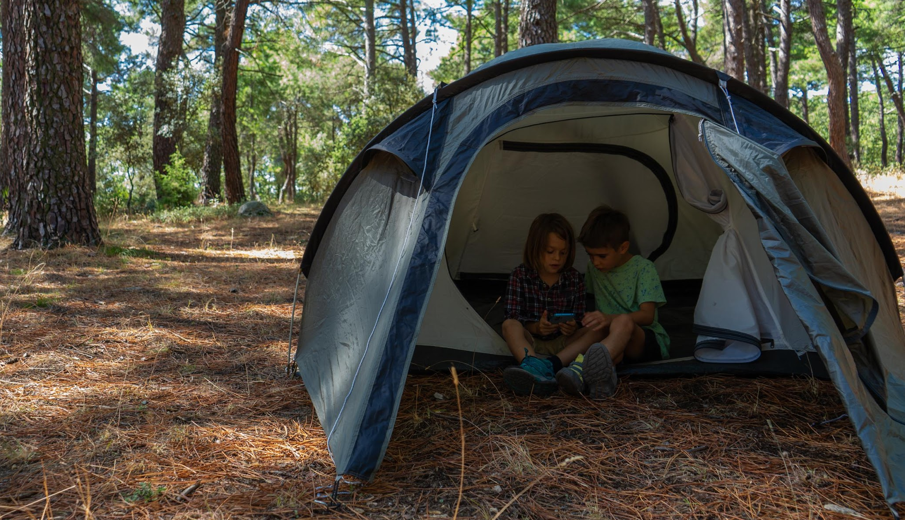
Harmful, abusive,
or illegal behaviors
Prioritize safety
Involve systems to help
Relationship
SYSTEM RESPONSE & SAFETY PLANNING
Seek additional help as needed
Notes:
Suggested script:
In all prevention levels, in all scenarios, safety should be first and foremost for all children involved.
In the red prevention continuum level in particular, safety planning is intensive and most often includes a system response, to help with safety planning for everyone involved.
Current safety planning is reviewed. Likely the plan will need some adapting to the situation. Questions such as whether the child engaging in harmful behaviors can be alone unsupervised with other youth and similar questions may come up,
Some safety planning changes in the home and in other social settings will be more permanent, while others will be temporary. For example, having a bell on a child's doorknob may be temporary, but having one child sleep upstairs and another sleep downstairs may be permanent.
Also, when a child has sexually harmed another child, we should report this to the authorities, such as child protection services. Whenever you have concerns or evidence of a child being abused or a child harming another, contact your local Child Protective Services.
And depending on what happened, there may be various professionals involved such as child protective services, law enforcement, the legal system, school counselor or nurse, etc.
Throughout our response, we need to strive to maintain a positive, caring and respectful relationship with the youth. How adults respond will help determine a youth’s own interpretation of what’s happening – and their engagement in safety planning and professional supports. When a child or teen has disclosed harm or abuse, or if we’ve discovered that a youth has been harmed or is harming someone, our initial reaction sets the tone for all involved.
The goal is to minimize stress and trauma and ensure that all children involved feel loved, cared for, and supported.
And last, but not least, it is vital to seek professional help from a counselor or therapist . Partnering with a professional is essential for educating the youth about the impact of their behaviors and help them adopt new safe behaviors, and for ongoing care to regularly assess what's happening, and help the child who harmed to build confidence in their ability to learn safe behaviors and to behave safely.
For a child that was harmed, professional help can support them in processing and healing. And for a youth who is causing harm, it is critical to support that youth with counseling that is specialized in helping youth with their behaviors and relationships.

Slide 30

Activity
Select the action steps that would be appropriate based on the following situation:
Your 11 year old told you their twin forced them to have oral sex.
What should you do?
Notes:
Optional
Suggested script:
Let’s give you a chance to think about how you might reply to a situation.
Activity: Let participants know that you’re going to be doing a poll/quiz (in Zoom/on paper).
Instructions: You’re going to read out a short scenario that’s also up on their screen. Then you’ll give them a number of statements – they should select yes or no for each action step based on the situation provided. Yes means you should take that step. No means you should not take that step.
Situation: Your 11 year old told you their twin forced them to have oral sex. What should you do?
Multiple choice questions:
1. Tell the child who was forcing their sibling to engage in oral sex that this is perverted and they could go to jail.
Answer: No.
Discussion point: While learning about child-child sexual harm or abuse can be shocking and scary, both children here still need support, care and love. Shaming and using scare tactics aren’t as helpful as talking about what next steps will look like so that everyone can be safe.
2. Call the police and get them involved
Answer: No.
Discussion point: If the child engaging in the harmful behavior were older – like closer to or above the age of consent – this may be appropriate.
3 . Include other systems as needed, like Child Protective Services
Answer: Yes.
Discussion point: CPS does investigate child-child sexual harm and abuse. They can help make sure both children are supported and have the resources they need to heal.
4. Check in with the child engaging in the unsafe behavior and ask them, “where did you get this idea from?”
Answer: Yes.
Discussion point: As we discussed in the yellow example, asking a child an open-ended question can help us sometimes learn more about why a child is engaging in an unsafe behavior. Continuing to press this child for more information if they’re feeling hesitant is not a good idea as that can sometimes cause them to shut down. Let your child know you’re always there to talk if they have questions or if anyone broke a rule with them.
5. Seek out a therapist for both children
Answer: Yes.
Discussion point: Both children need support to heal. Although treatment may look different, it’s important that youth are able to process any feelings from this incident. There are specialists both for the child who harmed and the child who was harmed. And, a professional can often help you learn more about why certain behaviors are happening.
6. Make sure your family safety plan matches the current concerns
Answer: Yes.
Discussion point: This is serious so environmental considerations are needed. It may be that a child needs to temporarily have a different room or an alarm on their door. Safety is paramount; a therapist can help more with these types of needs as well.
7. Increase supervision, and make sure your child is always supervised around other kids right now
Answer: Yes.
Discussion point: There should always be an involved caregiver watching your child who crossed boundaries so they can intervene, talk about safety and follow up as needed. This child should never be left alone – even if just for a minute – around other kids.

Slide 31
Activity: Continuum of Youth Behaviors
Safe, healthy, developmentally-appropriate
Concerning, inappropriate
Harmful (Abuse)
What is the prevention level?
What is your response?
Consider:
Motivation
Dynamic
Activity
Affect
Notes:
Suggested script:
Let’s do an activity now, looking at behaviors and thinking about what prevention continuum level they appear. We are going to give you a very brief description of a behavior between an adult and a child. These are only a single sentence, but when you read this behavior, what prevention continuum level would you most likely think that you are dealing with?
Virtual (Zoom) Instructions : Each behavior noted below should be a poll question, with the 3 prevention continuums listed as possible answers. Post each poll (in no particular order) one at a time, waiting for participants to respond. After the poll has been closed, discuss the results. Suggested discussion questions can include:
What was the most chosen prevention level, and ask for participants who chose that level to comment on why they chose that – what information led to their choice? This could be repeated for each level chosen in the poll
Ask participants what would have changed their choice (if yellow, to red or green, etc.).
Share how Now! identified the prevention level and discuss
Provide information to correct misconceptions about behaviors and prevention levels.
In-person Instructions: write down each behavior on a slip of paper, depending on size of the group, the behaviors can be duplicated, or trainer can create additional behaviors.
Prepare room by placing a sheet of green, yellow and red construction paper each in a corner of the room
Hand out the slips of paper with the behavior, instructing participants to choose the color-coded corner that best reflects the prevention level of the behavior, and instruct them not to speak to each other as they made their decision and moved to the corresponding corner.
Starting with those in the “green” corner, ask participants to read the behaviors handed out to them out loud. If more than one of the same behavior was given out, ask if anyone else has that behavior and notice what prevention level they went to.
Discuss as suggested above
Discussion points throughout activity:
Sometimes we may start at one prevention level, but when we gather additional information, we realize that actually things are either more serious than we thought – or that actually, a green prevention level response is more appropriate.
If many participants chose the “wrong” prevention level, acknowledge that our own experiences and relationships may impact our observations and analysis – and that is ok, these are tools we use to make informed decisions – so even if we perceive a situation to be less concerning or more so than the answers on this poll might indicate, we can still learn more about the situation, talk to others and make shifts in our perception as necessary
Be prepared for participants to perceive red prevention levels when the behaviors are considered yellow, and use this opportunity to reinforce that red is when we have evidence and/or disclosure – that perceived intention is not enough.
Encourage conversation. It’s ok to not see things the same way. Sometimes there is just not enough information to know.
Sometimes it is so obvious that additional conversation isn’t necessary
Note: trainer might only use a couple of these behaviors out of the choices below and trainer might want to substitute their own examples.
Poll 1: A 4-year-old is found touching their private parts in the bathroom at home For discussion: We see this as a green prevention level behavior - However, if the child did this in public, or amongst friends at pre-school, it would be a yellow prevention level behavior. But if it is in private, at home, then this is a green behavior, healthy and safe. Poll 2: A 14-year-old shows a 7-year-old adult pornography For discussion: This is a red prevention level situation, and it is harmful. And, it is illegal for minors to access and view pornographic material. While we know that a 14-year-old is still learning about boundaries and safety, this is an unsafe choice and is likely something they are aware isn’t OK to do—-even if they don’t know the impacts of showing a young child sexual content. This needs to stop. Further, it is clear this older child could use more support and guidance (potentially including professional support) around safe behaviors both around online content, and in person with younger kids. This 7-year-old would also benefit from support as this may have been confusing and upsetting. Poll 3: Two 11-year-olds are found naked in a room together. For discussion: This is a yellow prevention level example. While it may be developmentally appropriate for very young children to want to play without clothes, for adolescents it is beyond their developmental stage. At this age, it is important for kids to follow basic safety rules like nudity is private, and play happens when everyone is fully clothed. This requires intervention in the moment, and safety planning moving forward. Poll 4: A 9-year-old tells a 6-year-old that they want to touch the younger child’s private parts For discussion: This is a yellow prevention level behavior - a very clear warning sign that requires a response. We would want to know what’s coming up for this 9-year-old, to clarify that this isn’t a safe way to behave with anyone, and to make sure they know that they can come to a safe adult in their life if they have questions about bodies. We would also want to make sure both kids knows this is not a safe way for anyone to talk, and that they should always tell an adult they trust if someone says something about their body or touching them. Poll 5:
A 16-year-old films a 10-year-old taking a bath For discussion: This is a red prevention level behavior. It is harmful for a teen to film a naked child, as nudity is private and images like this may be considered exploitative and even abusive. This teen is much older than the bathing child, which enhances the power dynamic here. This requires intervention and clarity around boundaries, privacy, and appropriate spaces for technology. Other external professional supports may be appropriate, depending on other factors. Poll 6:
A 12-year-old describes to another 12-year-old what oral sex means For discussion: This is yellow prevention level behavior. While it is appropriate for two twelve-year-olds to be wondering about this, we consider this within the yellow prevention category because there is ample opportunity for redirection. These youth both could benefit from healthy sexuality information from a trusted source, like a book or adolescent-focused site. We might also ask, “where did you get the idea around this?”, as they may have learned about this from an age-inappropriate source initially.

Slide 32
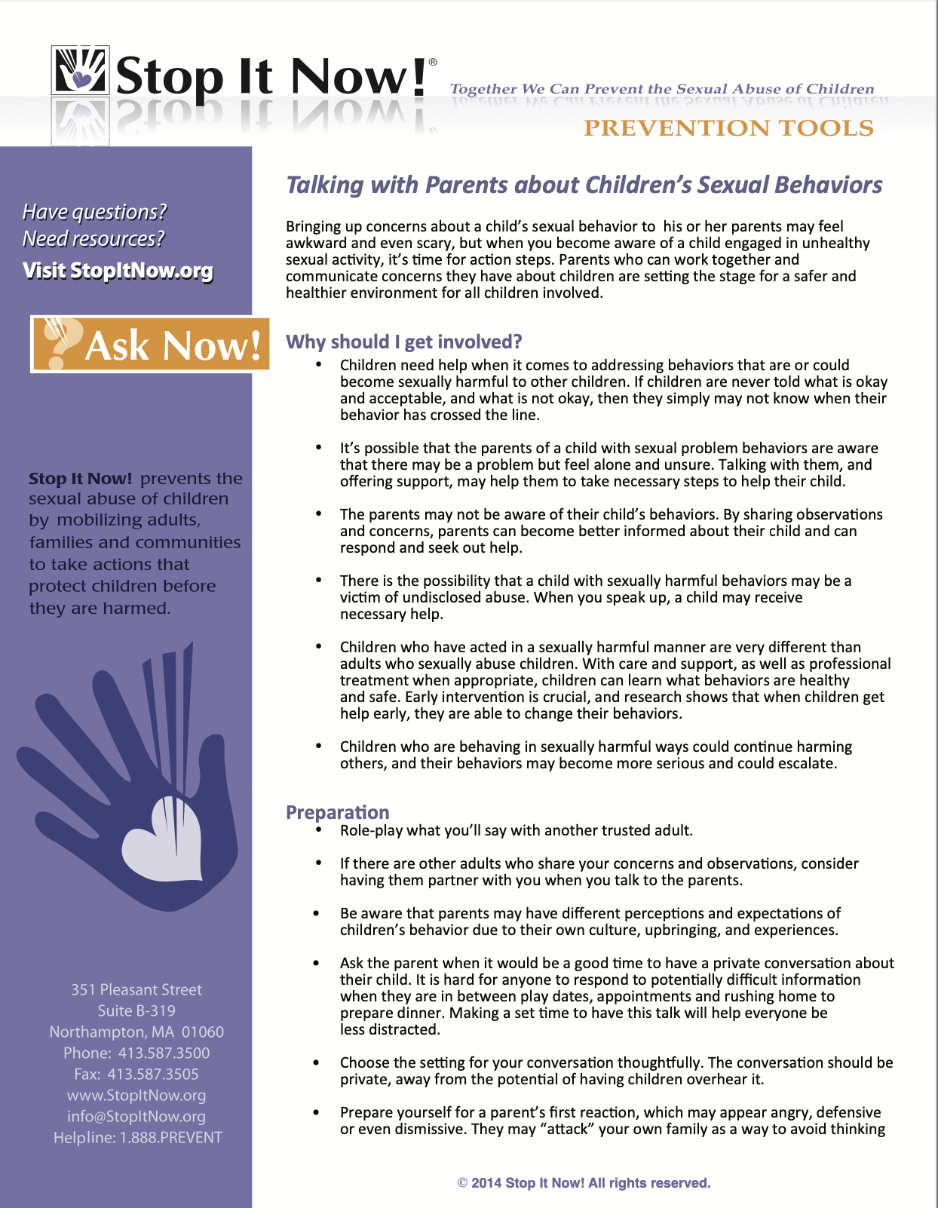
Talking with Other Parents
Tipsheet:
Talking with Parents about Children’s Sexual Behaviors
Notes:
Suggested script:
As we wrap up talking about children’s behaviors, let’s talk about what to if you are a parent or caregiver who has witnessed someone else’s child displaying problematic sexual behaviors.
Talking to another adult about their child’s inappropriate behaviors is hard enough, even if we’re talking about things like the child’s manners or non-sexual behaviors.
But when the discussion is about sexual behaviors, it can be even more difficult.
Our Tipsheet: Talking with Parents About Children’s Sexual Behaviors is a good reference and can be found in your handouts section.
While this was written primarily for parents talking to parents, it can be helpful no matter what your role is with a child.

Slide 33

Why Talk to Other Parents?
Parent thought behavior would stop
Parent is unaware
Parent needed prompt to get child help
Parent has not educated their child
Notes:
Suggested script:
There are a number of reasons it is helpful to speak up to another parent about their child’s sexual behaviors.
>ADVANCE SLIDE
Perhaps this parent isn’t informed about children’s sexual development and safety. If that’s the case, it is unlikely they are aware there is a problem.
By talking with the parent about your observations you are providing them with an opportunity to learn more about protecting their children and others, including your own.
>ADVANCE SLIDE
Or it could be that the parent has not spoken with their own children about that child’s personal boundaries and safe behaviors towards others. By sharing your observations, the parent may recognize the need to talk to and educate their child about the expectations for that child to also behave safely with other children.
>ADVANCE SLIDE
Or maybe the parent is aware that their child is exhibiting some concerning behaviors but thought it would go away or get better on its own. Through your discussion with them, it may prompt the parent to take their own concerns more seriously and seek professional help.
>ADVANCE SLIDE
Early intervention with children with problematic sexual behavior is crucial, and research shows that when children are provided with the tools they need, they are able to change their behaviors.

Slide 34


Notes:
Use for transition between workshop 2A and workshop 2B

Slide 35

Notes:
Suggested script:
Now that we’ve talked about children’s behaviors and how to respond, let’s move on to talking about adult’s behaviors – and how to speak up to other adults when there’s a concern.

Slide 36

Continuum of Adult Behaviors
 | Safe, Healthy, Developmentally Appropriate
 | Concerning, Inappropriate
 | Abusive
Notes:
Suggested script:
Just like when we looked at children’s behaviors, this green, yellow, red continuum helps us understand the behaviors we’re seeing in adults so we know how to respond.

Slide 37
Continuum of Adult Behaviors
Safe, healthy, appropriate behaviors
Unsafe, concerning, inappropriate behaviors
Harmful, abusive, or illegal behaviors
Healthy and developmentally appropriate behaviors between adult and youth
Behaviors that cross boundaries, violate safety rules or policies/procedures
Sexual behaviors or activities with a child or youth
Notes:
Suggested script:
So to learn about the risks of children, let’s look first at our Green prevention level as we think about specifically about adults’ behaviors and establish our baseline of healthy and safe behaviors.
>ADVANCE SLIDE
Adult behaviors in the green prevention continuum are the healthy involved, loving, nurturing, supportive, educational behaviors that adults engage in with children that are based on helping a child thrive and grow in a healthy, safe and developmentally appropriately manner. They are not specific to healthy sexual development but really for a child’s overall safe and healthy growth. We spent a lot time earlier talking about these protective actions earlier but were specific to supporting healthy sexual development and relationships. Let’s think beyond that, and identify some general behaviors caregiving adults demonstrate to support children.
Ask: What are other general ways caregiving adults demonstrate care/support. (Give a few examples, such as tucking children into bed, showing them how to brush their teeth, playing a game with them). Some additional examples below:
Read to them
Teach and model social skills
Listen to them – really listen - eye contact, no distractions, asking questions
Provide nutritious (and yummy) meals
Clothe them
Teach them how to play an instrument
Praise
High fives
Hugs – child initiated and/or mutual
Others
>ADVANCE SLIDE
And just like the children’s prevention continuum:
Adult’s behaviors in the yellow continuum are behaviors that raise warning signs that someone is struggling with boundaries, rules, and safe behaviors – and could pose a risk to children. Sometimes we may identify warning signs but that doesn’t mean that an adult is someone who has harmed or abused someone else – like in the story about the community picnic where one person was saying inappropriate things around children. When someone engages in inappropriate behaviors around children, while they may not be at-risk for abusing children, they are creating a more vulnerable environment.
>ADVANCE SLIDE
And “red” behaviors—these are the behaviors that are causing sexual harm and are abusive. There is evidence, a disclosure or someone walked in on a child being abused. Red behaviors are always illegal when we’re talking about adults.

Slide 38

Who Sexually Abuses Kids?
Any age, including another youth
Any economic status
Any educational background
Any race or culture
Any religious belief
Any gender or sexual orientation
Notes:
Suggested script:
Ask: Can anyone tell me what someone who sexually abuses children might look like, or anything about their lifestyle and culture – like what they do, where they live, etc.?
Encourage conversation, acknowledging answers
If someone says, “Anyone” – Exactly, really anyone at all can be someone who engages in sexually abusive behavior
If answers are offered that try to describe someone, i.e. “particular genders, race, physical/mental health status, economic, educational status, etc.” say, “Actually anyone at all can be someone who engages in sexually abusive behavior
And expand with:
People who sexually abuse a child can be:
>ADVANCE SLIDE
Any age – adults of all ages – including older adults – can sexually abuse a child. And, as we’re talked about children and youth can also sexually harm another child.
>ADVANCE SLIDE
They can be from any economic or educational background. It doesn’t matter what job they have or what role they have in the community. Sex abuse crosses all economic and educational lines.
>ADVANCE SLIDE
They can be from any race or any culture, from anywhere in the world. There is no one race or culture that “produces” more adults who sexually abuse children
>ADVANCE SLIDE
Or from any religious belief While a person who has sexually abused a child may have experiences that are connected to their experience with faith and belief, this is in no way “causes” someone to be an adult who sexually abuses children
>ADVANCE SLIDE
Likewise, there is no evidence that a person’s gender or sexual orientation “causes” them to become sexually attracted to children. There are plenty of adults who have noted that their primary sexual attraction is to a different gender, yet have sexually abused same gendered children. On the Stop It Now! Helpline, we have had questions about whether being abused, “turns someone gay” and what we do know is that growing up gay can increase a child’s overall vulnerability. Folks who are at risk to harm children (and this can even include same-age “bullies”), look for vulnerable children.
The bottom line is: it can be anyone, and we can’t know just by looking at someone. The stereotypes we’ve seen on television and movies are not accurate.
Ask: Any questions or other thoughts?

Slide 39

Not all people who sexually abuse children have pedophilia.
Notes:
Suggested script:
It is also important to understand not all people who sexually abuse children have pedophilia.
It is estimated that between 25 – 40% of adults who abuse children are sexually attracted to children – that means more than half of people who sexually abuse children are NOT exclusively attracted to children and therefore do not have pedophilia. – that likely do not fit the diagnosis for pedophilia

Slide 40

Some people who sexually harm children:
Have an attraction to children
Have addiction related issues or compulsive behaviors
Have psychiatric conditions or mental illness
Have cognitive, emotional, or intellectual differences
Abuse children because of stressors
Were abused themselves
Notes:
Suggested script:
So, why do adults sexually abuse children?
>ADVANCE SLIDE
Some people who sexually harm children do so because they have a sexual attraction to children – and fit a diagnostic criteria for pedophilia
There are other reasons adults sexually abuse a child as well. The reasons are not to be viewed as excuses for the abuse, instead we should use the reasons to understand what could be done to help provide support and resources with the goal to stop and/or prevent abusive behaviors.
And it helps us understand why people without pedophilia might sexually abuse a child so we can put protective measures in place for the children we care about.
>ADVANCE SLIDE
Some people have addiction or substance related issues or compulsive behaviors.
>ADVANCE SLIDE
And some have other psychiatric issues that contribute to abuse - including major mental health conditions.
>ADVANCE SLIDE
Cognitive, emotional, or intellectual differences can also be a potential reason why someone is not able to understand and control their harmful behaviors
>ADVANCE SLIDE
And for some people, they may cross boundaries and abuse a child because of major stressors in their lives when they don’t have good coping skills - such as losing their job, being isolated, or other relationship difficulties.
>ADVANCE SLIDE
And sometimes an adult may sexually abuse a child because of their own experience of being abused and never having received appropriate follow up care and therapy. This is not to say that most or even a lot of survivors of child sexual abuse grow up and sexually abuse a child. But many people who sexually abuse children have a history of some trauma.

Slide 41

What are some of the terms you use to describe a person with sexual attractions to minors or who sexually abused a minor?
Notes:
Suggested script:
Ask: What is some of the language you have used or heard others use to refer to people who sexually abuse children? Think about what terms you also hear in the media.
Note: may need to prompt with a couple of terms, i.e. “pervert, pedophile”
Collect answers, perhaps write on white board
As we move on, I’d like you to just hold that language in your mind

Slide 42
Defining Terms
Diagnostic term
A disorder characterized by recurrent, intense sexually arousing fantasies, urges, or behaviors involving sexual activity with prepubescent children.
Pedophilia
Descriptive term
Someone who has been diagnosed with pedophilia.
Pedophile
Legal term
A person convicted of a sexual offense.
Sex Offender
Notes:
Suggested script:
Let’s look at some of the more “professional” and common language often used when discussing someone who sexually abuses a child.
Take a look at the 3 terms on your slide.
Ask: Would anyone like to define these, while sharing how they are different?
Take answers/review as appropriate with notes below
>ADVANCE SLIDE
Pedophilia is a mental health diagnosis that refers to someone is sexually attracted to children and youth. Some people may have an exclusive form of pedophilia, meaning they are attracted only to children or they may have nonexclusive pedophilia, meaning they are also attracted to adults as well. There are also additional terms that describe attractions to other specific ages and physical developmental stages of children too (since pedophilia doesn’t include all youth).
>ADVANCE SLIDE
A pedophile is a descriptive term for someone who has been diagnosed with pedophilia. Pedophilia itself is not a crime and is not something an individual can be arrested for. The word pedophile is often thought of as someone who has already abused a child, but it doesn’t refer at all to someone’s actions, only to their feelings and thoughts.
>ADVANCE SLIDE
Sex offender is a legal term for someone who has been charged, convicted and sentenced for a sex crime for either harming a youth or an adult. Most likely they are on the sex offender registry or have been on the sex offender registry at some point in their lives.
Many people who have sexually abused a child are not legally referred to as sex offenders because they haven’t been through the criminal justice system – meaning they haven’t been reported, arrested, charged and found guilty of a sex offense.

Slide 43

People DO reach out for help
Notes:
Suggested script:
Ask: Why is it relevant to prevention that we talk about how we talk about the adults who are at risk of abusing and who have abused?
Collect answers, commenting as appropriate and then review the following:
Because as we’ve shared, not all people with pedophilia sexually abuse children. – and it is important to understand this in our prevention goals.
Some people with pedophilia, can (and do) seek help to deal with these thoughts so they don’t harm a child.
The helplines at Stop It Now! hear from many people who are seeking help and holding themselves accountable for children’s safety.
This isn’t always easy for people to believe, but understanding that people can be responsible for behaving in safe ways, holding them accountable to do so, and helping them find the resources they need is necessary if we truly want to prevent child sex abuse.

Slide 44

Impact of Language
The language we use can impact safety, how caring adults think about safety, and how to help those in need.
Notes:
Suggested script:
Let’s think about the terms you use when talking about a person who has sexually abused children (refer back to some of the responses from the Defining Terms Slide responses). These terms bring up specific images and may actually be a barrier in taking preventive steps.
When thinking about prevention, it is more effective to use person-first language. This type of language is not a label but rather puts the person before their behavior, because no one is only their worst behavior – and as Gwen Willis, a researcher says, Why call someone by the very thing we don’t want them to be?”
Using language such as “predator, monster, or pervert” tends to put walls up, and it can impact how adults think about safety and how they help people in need. This language acts as a barrier – preventing us from being as proactive and protective as possible.
When the word, “monsters” is used – it implies we’re fighting “monsters” and can feel like you have to do something that seems really scary, maybe seems impossible , and that you need super warrior strength.
And also, if we’re so busy looking for the “monster” – we miss the subtle behaviors that may make an environment more vulnerable (like an adult talking in mature sexual terms around children). A person may not see warning signs in an adult at risk to abuse because that person is “too nice”. We know that we typically do know the people who sexually abuse children, and as we’ve said…we may very well love them, or the child loves them…so how could they be a monster?
And using 1st person language helps us see the person who might want help before they cross a line – and not someone who is beyond help already.

Slide 45



Person-First Language Examples
A person who sexually abused a child, or a person who is at-risk to abuse a child
A person with sexual behavior problems
A person who has committed a sexual offense (or a registered sex offender)
Notes:
Suggested script:
Let’s look at some examples of person first language. So instead of saying, “pedophile, pervert, abuser”, we can say:
A person (an adult or youth) who sexually abused a child, or a person who is at-risk to abuse a child.
A person with sexual behavior problems.
A person who has committed a sexual offense, although it is certainly common to hear the term “registered sex offender” for someone who has been convicted of the crime of sexual abuse.

Slide 46
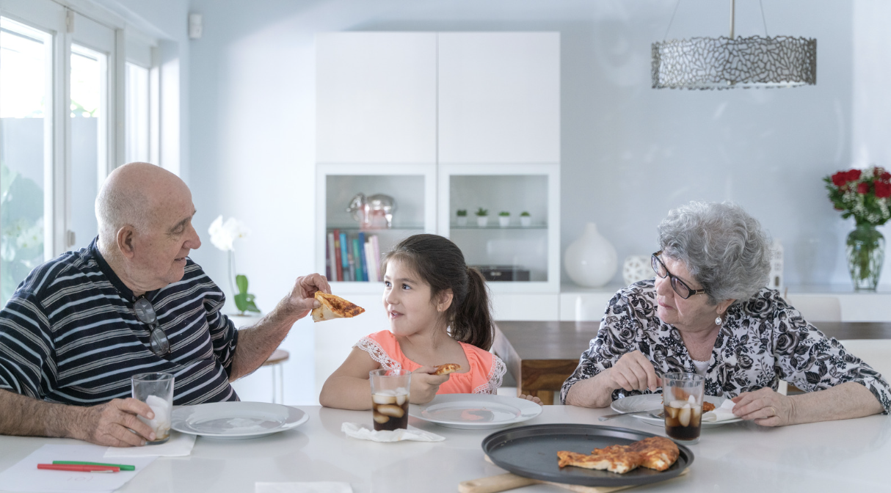
We need to focus on behavior which is visible, and NOT the reason or intent, which we can’t see.
Notes:
Suggested script:
Hopefully you are recognizing that if prevention is only based on hoping that we will recognize the “bad guy”, we are sorely mistaken, and we risk our children’s safety. If we think that only “bad people” abuse, we again are sorely mistaken, and we miss opportunities to prevent abuse and help everyone get the help they need.
We need to focus on behavior which is visible and NOT intent—which is not always known, often isn’t visible.
We just talked about the many possible reasons why people sexually abuse children. Sometimes we know the reasons why and other times we don’t know what influences a person to act.
Because of this, there is no one single way to address every person or every abuse situation.
So, what are concerned adults to do? How can they know when there is a risk? Since really – there is no big decal advertising an adult or youth who is at risk to abuse a child, we look at warning signs.
The sexual abuse of a child doesn’t happen all of a sudden. Someone who is feeling the urge to act on their sexual feelings towards a child, may unknowingly be sending out signals that they are at risk of abusing for quite a while. By being able to identify behaviors that could indicate that someone may be losing control, we may have the opportunity to intervene and to get every one the help they need before harm has taken place.
>ADVANCE SLIDE
So we need to focus on behavior, which is visible, and not the reason, or intent, which again, we just don’t always know.
Having this perspective helps us speak up to protect kids, because if we see someone behaving in a way that makes us feel uncomfortable, pauses us to think about safety - it often can feel less threatening or risky to talk to that person about safe behaviors - without accusing them of having the intent to be abusive.
We can talk about the safe behaviors all adults need to have around children, instead of just pointing out the behaviors of one person.

Slide 47

Reflection Activity
How confident are you?
I would be able to spot someone who is at risk of sexually abusing a child.
I would see warning signs in a trusted friend's behaviors that could mean that person is putting a youth at risk of harm.
I would know if someone intended to sexually abuse a child or teen I care for.
I can tell the difference between a well-intentioned, helpful family member and a person trying to get close to a child or teen to potentially abuse them.
I have considered that someone I love or someone I respect could behave in an unsafe way around a youth.
Notes:
Optional slide
Suggested script:
I’m going to ask you a few questions about how you’re feeling about your ability to recognize potential risks. Just reflect on these.
Trainer’s note: Ask the group the following questions (up on the slide too) - this can be done as a personal reflection or as a poll, with yes, no or unsure response choices. This is to help foster a personal reflective opportunity.
I would be able to spot someone who is at risk of sexually abusing a child.
I would see warning signs in a trusted friend's behaviors that could mean that person is putting a youth at risk of harm.
I would know if someone intended to sexually abuse a child or teen I care for.
I can tell the difference between a well-intentioned, helpful family member and a person trying to get close to a child or teen to potentially abuse them.
I have considered that someone I love or someone I respect could behave in an unsafe way around a youth.
Debrief (optional)
You may feel confident in your abilities to recognize warning signs in an adult’s behaviors toward children, or you may not feel so confident.
And these aren’t always easy to do, even for trained individuals.

Slide 48

A person who is at risk of sexually harming a child typically demonstrates behaviors that may be warning signs before they abuse a child.
Notes:
Suggested script:
If you feel unsure about whether you would be able to recognize someone who might be at-risk to harm kids – you are not alone.
However you can learn to better identify behaviors in adults that are warning signs and can create unsafe environments for children.
>ADVANCE SLIDE
As we just noted, child sexual abuse doesn’t usually happen all of a sudden.
A person who is at-risk of sexually abusing a child typically demonstrates behaviors that we identify as increasing the risk to a child.
These signs aren’t always easy to spot, especially for a child or teen - they can be subtle - but by learning more about the indicators that a behavior is potentially unsafe, unhealthy, or even abusive, you can actually then become more aware of opportunities to intervene before abuse happens.
These warning signs – are the time to act, and the time to speak up.

Slide 49

Consider the possibility that we know someone who poses a risk to children.
Notes:
Suggested script:
But again, to do this requires us to consider the possibility that ANYONE can sexually abuse a child – including those we love.
>ADVANCE SLIDE
It requires us to believe that it can happen by someone we know, live with, or work with, or someone who is a “good” person, or a great member of the community. Or we won’t pay attention to warning signs in the people we know and likely trust and/or respect.
This is one of the biggest challenges we all face. It’s hard to believe that someone we know, love, trust or respect could sexually abuse children.

Slide 50
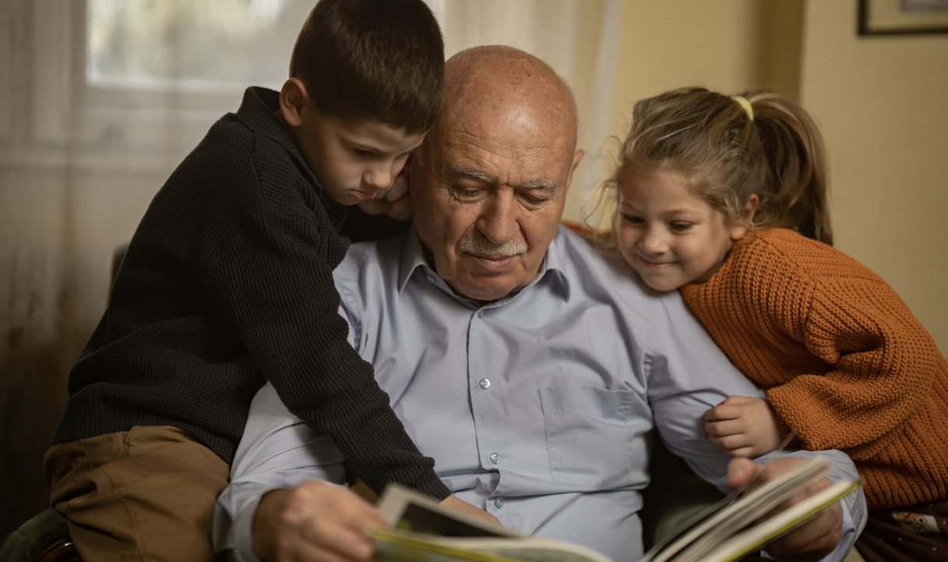
We can identify and respond to concerning behaviors proactively.
We can let other adults know our #1 priority is safeguarding children.
We can’t see or know someone’s intent.
We can talk to adults as well as kids about safety.
Notes:
Suggested script:
People who sexually abuse children don’t want their behavior to be known. They want to appear friendly, trustworthy, helpful, and caring. They want to make it hard for people to think that they could hurt a child. They may even go out of their way to be helpful, friendly, and to “groom” the adults around them as much as the child.
>ADVANCE SLIDE
So, while just can’t always know why someone acts the way they do…
>ADVANCE SLIDE
We CAN learn what warning signs in behavior look like. By really paying attention to behaviors that adults engage in when they are around children, we can identify when an adult may be acting in a way that could be harmful to a child.
And then we can respond to those behaviors proactively.
>ADVANCE SLIDE
And we can talk to adults as well as kids. We’ll talk about this more but what is critical to understand here is that by recognizing early warning signs in someone’s behaviors, we might have the opportunity to speak up early, set boundaries, and engage our safety plans
>ADVANCE SLIDE
Also, we can let other adults know our #1 priority is safeguarding children. When we pay attention and speak up, the message is that children are safe with us and that you are a vigilant, protective adult in a child’s life - and that, in and of itself, tells people that the child you care about is not as vulnerable.

Slide 51
Prevention Continuum
Safe, healthy, appropriate behaviors
Unsafe, concerning, inappropriate behaviors
Abusive and/or illegal behaviors
Behaviors that cross boundaries, violate safety rules or policies/procedures
Notes:
Suggested script:
And that brings us to the yellow prevention continuum

Slide 52
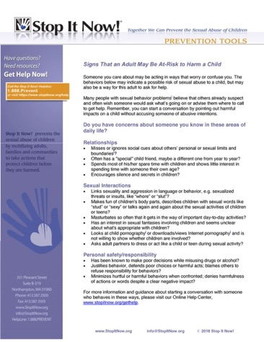
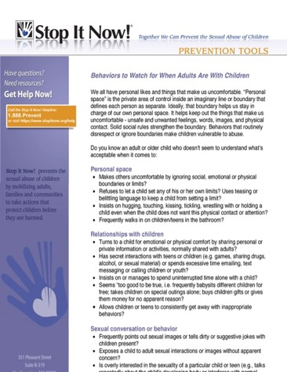
Yellow Behaviors in Adults
People often think they can’t speak up or act unless they have “proof” that someone has done something wrong.
However, we don’t need proof to act within our safety plan or within our organization’s policies and procedures and act to protect children.
Signs an Adult is At-Risk to Harm a Child
Behaviors to Watch Out For When Adults are with Children
Notes:
Suggested script:
There are two handouts relevant for this discussion if you’d like to have those available while we talk through yellow behaviors:
Signs an Adult is At-Risk to Harm a Child
and Behaviors to Watch Out for When Adults are with Children
>ADVANCE SLIDE
People often think they can’t speak up or act unless they have “proof” that someone has actually done something harmful. This is another barrier to taking steps in response to concerns about a child's safety – similar to the fear of being wrong.
But we don’t need proof of harm to act when we have a concern – in our home, in our community, in the places where our children and teens are found.
Remember, we can’t usually know what someone’s intent is, but we can observe and call out behaviors that could pose a risk to youth.
We can raise concerns, ask questions, gather more information, restate safety rules - all without making accusations. This promotes a safe environment proactively vs. waiting until abuse has happened.
Addressing concerns through talking about behaviors proactively avoids accusations, and this is important because since behaviors don’t always tell us what a person intends, and we can’t know that an adult will abuse a child based solely on their behaviors, we want to have a discussion about safe behaviors – not a discussion that accuses someone of having abusive intent. We are not calling someone a possible monster, rather we are letting them know that their behavior is not safe, in violation of our safety plan, or organization's policies and procedures. And this helps us have a conversation that is productive and not antagonistic

Slide 53

Signs that an adult is at-risk to abuse a child
Notes:
Suggested script:
You have likely heard the term grooming to describe the process used by an adult to gain a child’s trust and cooperation in an effort to sexually abuse them, and this has been used as a way to describe an adult's behaviors that assumes that adult is attempting to sexually abuse the child.
However, the words “grooming” can actually be confusing for both youth and adults because many grooming behaviors can appear to be loving, nurturing behaviors – such as spending extra time with a child or praising a teenager. And when we say someone is displaying grooming behaviors, it is very likely that what is heard is, "you are acting like a child abuser" - and then a calm and rational conversation that focuses on safe behaviors is much more difficult.
So instead, as we just said we want to focus on specific behaviors that are warning signs that could put a child is at risk, increase the risk in the environment – regardless of the reason for the behaviors.
When we’re talking with other adults about any concerns we have with them around children, we can talk about their behavior - the specific behaviors we’re seeing that are concerning or break a safety rule vs. saying we’re concerned they are “grooming” a child or teen.
Additionally - someone who demonstrates warning behaviors is not necessarily going to sexually abuse children – however, if you recall the example with the adult at the (community gathering) - behaviors that cross boundaries, that ignore safety rules and make people uncomfortable can increase the overall vulnerability of both the child or youth – and the environment.
One thing we can do is look for the frequency of these behaviors, or for clusters of many warning sign behaviors – and also for behaviors that don’t respond to redirection, reminders of rules and policies, or just plain requests to stop the behavior. Yes, there are safe, well-meaning adults that may seem vague on a boundary – this is why the language grooming can be difficult too – like if a new coach who seems to be spending too much concentrated with one team player – but when they are reminded of policies about 1:1 time with the kids, and is engaged in a conversation about sharing their attention equally, they change their behavior, then we can feel more confident that this is not a person at-risk to harm a child, but rather, with support and education can continue to create strong protective environments for kids.

Slide 54
Yellow Behaviors in Adults
Unsafe, concerning, inappropriate behaviors
Focus on Children
“Too good to be true”
Seeks 1:1 time with children
Singles out a particular child
Difficulty with same-age peer (adult) relationships
Notes:
Suggested script:
To begin recognizing warning behaviors, let’s start by looking at an adult’s focus on children. A reminder, we don't automatically become concerned when we see a single concerning behavior or two. Rather, we pay attention to repeated behaviors that cross boundaries and make us uncomfortable or to the occurrence of several warning sign behaviors.
>ADVANCE SLIDE
Adults that are helpful and focus on children a lot may often be seen as “too good to be true.” For example, they may frequently offer to babysit children for free, take children on special outings, buy kids gifts, or give them money for no particular reason. They are frequently, if not always, available to be with children.
>ADVANCE SLIDE
They may also spend a lot of one-on-one time with youth, and often try to create situations where they are alone with children. And they may try to develop a relationship with a child or youth, where this child feels like no one else really understands them like this adult does…deepening their dependence and admiration of that adult
>ADVANCE SLIDE
Another concerning behavior is when an adult repeatedly singles out a particular child or teen for special attention. They may even have one youth that is a “special friend.” Pay attention to an adult that voices a constant admiration of a child, frequently touches a child, or again - acts like they understand the child better than anyone else.
>ADVANCE SLIDE
Also we pay attention to adults who show little interest in spending time with other adults, who have difficulty with relationships with people their own age, or those who prefer time with children or get along better with children. We may enjoy spending time with kids…but there when that is preferred to spending time with adults,

Slide 55
Yellow Behaviors in Adults
Unsafe, concerning, inappropriate behaviors
Boundaries
Don’t follow rules & codes of conduct
Violate boundaries, like not respecting privacy or ignoring social cues about personal or sexual limits and boundaries
Makes excuses for harmful behavior
Tries to control a child’s behavior through secrecy and doesn’t allow a child to say no to unwanted touch or activities
Notes:
Suggested script:
We should also pay attention to an adult’s boundaries.
Boundaries are a tool to keep us all safe. They may be formal boundaries – like specific rules, or they could be unspoken boundaries about how far we stand from someone else when we’re talking to them. So, when an adult breaks boundaries or seems to even be vague on them, this could create an unsafe situation for a child.
>ADVANCE SLIDE
So we pay attention to adults who don’t follow family safety plans, rules, guidelines, or institutional policies or codes of conduct is a concern.
>ADVANCE SLIDE
And as I stated, when an adult violates boundaries or seems vague about them, this could create an unsafe situation for a child.
For example, an adult that doesn’t allow children and teens privacy and walks in on them in the bathroom, or an adult who misses or ignores social cues about personal or sexual limits and boundaries. Maybe they just seem awkward, but even minor boundary violations require our attention.
>ADVANCE SLIDE
It is also a warning sign when an adult doesn’t hold themselves or others accountable, if they make excuses for their behavior, or let the concerning behaviors of others slide. Difficulty in taking responsibility, always blaming someone else or a situation for risky and harmful behaviors is a warning sign. Healthy adults are able to be accountable – they do not put children in dangerous situations.
>ADVANCE SLIDE
And when a kid is discouraged from telling other adults about a relationship or situation, or when a child is not able to say no or set their own boundaries for unwanted touch or other activities, this is also a warning sign. Any time an adult encourages secrets between a child and an adult, we pay attention. Encouraging secrets with children can put them at risk. This can encourage children to believe it is ok to have secrets with adults and if there is an adult with an intention to cause harm, a child may not think twice about keeping the actions of that adult a secret.

Slide 56
Yellow Behaviors in Adults
Unsafe, concerning, inappropriate behaviors
Relationship Difficulties
Treats children as peers
Turns to children for comfort
Undermines parental authority and relationship
Notes:
Suggested script:
Moving on now to adult’s relationships and difficulties that can also alert us to potentially concerning behaviors.
Have you ever seen an adult treat a child or teen more like an adult, a peer? Maybe they just don’t seem to get what’s appropriate around children. They do not seem to understand the difference in relationships between adults and children, and those relationships with same aged folks. This category of warning signs includes secret interactions with teens or children (e.g. games, sharing drugs, alcohol, or sexual material) or spending excessive time to emailing, text messaging or calling children or youth – and even more so, if these forms of communication are not allowed according to program policies.
Other behaviors that could be at-risk indicators in adults can include:
>ADVANCE SLIDE
When an adult doesn’t recognize characteristics of an appropriate relationship with a child or teen, and treats a kid like a peer or another adult, for example talking with a youth about mature matters, like job stress, finances or other adult relationships and matters.
>ADVANCE SLIDE
It is also concerning when an adult seeks out a child or teenager for their own emotional or physical comfort; or shares personal or private information or activities with a youth instead of with someone their own age.
>ADVANCE SLIDE
Also adults who try to dismiss other authority figures in a child or teen’s life like parents, school staff, or other people that work with kids - can be setting up a situation where the youth believes that this adult is the only adult that cares about them or has their best interests at heart. This might sound like, "oh, what do your parents know... they just want to control you."
This decreases the circle of safety around that youth, and it can make them reliant exclusively on that adult which increases their vulnerability and risk of being abused.

Slide 57
Consider the Context
NEEDS
Whose needs are being met?
Do behaviors continue after clear limits have been set?
BEHAVIORS
PARENTAL AUTHORITY
Is parental authority being undermined?
FOCUS
Is one child singled out?
CONTROL
Can a child say “no”?
Notes:
Suggested script:
Sometimes it may be hard to tell if a behavior is concerning.
For example, you have a family member that is super attentive and loving, and very affectionate with your 11-year-old, or a coworker that brings your child gifts from their travels. Should you be concerned?
There are some questions that can helps you consider the context of what you’re seeing and help you determine if it’s a concerning behavior.
>ADVANCE SLIDE
First, whose needs are being met? Although we may sometimes tell children what to do to meet our needs, adults’ interactions with children should focus on a child’s needs.
For example, telling a child “hurry up, so I won’t be late to work” is addressing our need being on time to work – which in turn helps us keep our job and provide for the kids we care for. But when an adult asks a child to do something that has no benefit to the child, this is an important consideration.
>ADVANCE SLIDE
Next, do the behaviors continue after clear limits have been set? If an adult has been informed about a safety plan, a family rule, or a program policy and still continues with the behavior, this is a warning sign that a child may be at risk.
Adults sometimes break a rule or cross a boundary, but when told they have crossed a boundary – safe people do not ignore the feedback and instructions.
>ADVANCE SLIDE
Is parental authority being undermined? If the behavior is not okay with the parent or caregiver, this can signify an unhealthy or unsafe relationship with a child or teen. Examples of this would include an adult telling a youth not to let a parent know about a situation or allowing a young person to do things that conflict with family rules and values.
This can confuse a child and also later be used to keep that youth quiet.
>ADVANCE SLIDE
Is one child singled out? If an adult’s attention seems focused on a single child and doesn't treat other children equally, this is concerning.
>ADVANCE SLIDE
And finally – can a child say no? – Children and teenagers need to be able to say no to unwanted or unsafe touches or situations. An adult who expects a child or youth to do everything they say, and have exclusive control over a child, is a warning sign.

Slide 58

Trust your instincts!
Review Stop It Now! tip sheets.
Talk with others about your concerns to help you get clarity and support.
Notes:
Suggested script:
Sometimes you may find yourself in a situation where something doesn’t feel right but you just aren’t sure.
Your instincts are powerful – don’t ignore them.
>ADVANCE SLIDE
If you have a gut feeling that something is wrong, review our warning sign tip sheets – the handouts called Signs an Adult is At-Risk to Harm a Child and Behaviors to Watch Out for When Adults are with Children. These can help you put words to your concerns and help you describe the warning signs you are seeing.
>ADVANCE SLIDE
You might also want to talk with others – maybe another parent, a colleague, a spouse, mentor, boss – about what is concerning you.
It may be that you’re not the only one seeing something, and this can help you find support, which in turn can help you take next steps to keep a child safe.

Slide 59
When an adult is displaying yellow behaviors, they may be struggling with boundaries, rules, or making safe choices – and could pose a risk to children.
Unsafe, concerning, inappropriate behaviors
When an adult is displaying yellow behaviors, they may be struggling with boundaries, rules, or making safe choices – and could pose a risk to children.
This is where speaking up and acting is critical.
RESPOND & PROTECT
Notes:
Suggested script:
As we wrap up looking at warning sign behaviors, you can see how Identifying behaviors in the yellow prevention level is critical because this is where we can be most proactive and help stop harm to a youth before it happens.
Sometimes we may identify warning signs, and it doesn’t always mean an adult intends to hurt a child –
>ADVANCE SLIDE
But when an adult’s behaviors are concerning or they are struggling with boundaries, rules, or making safe choices – our responsibility is to respond.
>ADVANCE SLIDE
This is where speaking up and acting is critical.

Slide 60
Prevention Continuum
Safe, healthy, appropriate behaviors
Unsafe, concerning, inappropriate behaviors
Abusive and/or illegal behaviors
Sexual behaviors or activities with youth
Notes:
Suggested script:
Let’s move on to adult’s behaviors in the red prevention continuum level

Slide 61
When an adult is displaying yellow behaviors, they may be struggling with boundaries, rules, or making safe choices – and could pose a risk to children.
Harmful, abusive, illegal behaviors
Contact & Non-Contact Behaviors
Touching a child’s genitals or private parts for sexual purposes Making a child touch someone else’s genitals Playing sexual games Putting objects or body parts (like fingers, tongue, or penis) inside the vagina, mouth, or anus of a child Showing a child pornography Deliberately exposing an adult’s genitals to a child Photographing or videotaping a child without clothes on and/or in sexual poses Encouraging or forcing a child to watch or listen to sexual acts Watching a child undress or use the bathroom
SYSTEM RESPONSE & SAFETY PLANNING
Notes:
Suggested script:
Red behaviors are both contact and non-contact sexual behaviors between adults and children – we talked about these early in this training, read through these examples of both contact and non-contact sexually abusive behaviors between an adult and a child
Either let participants read in silence, or read out loud
ASK: Does anyone have any questions about these?
These are abusive behaviors and they are illegal. These behaviors require a response with professionals and safety planning to protect the child.

Slide 62

Reporting
Notes:
Suggested script:
As a reminder, even if you are not considered a mandated reporter in your role or state, we encourage all adults to report suspected or disclosed abuse to the authorities such as child protective services, to work with the system created to support children and families and to help protect the child involved.

Slide 63
Activity: Continuum of Adult Behaviors
Safe, healthy, developmentally-appropriate | Concerning, inappropriate | Abusive
Notes:
Suggested script:
Activity (large group activity):
Let’s do an activity now, looking at behaviors and thinking about what prevention continuum level they appear. We are going to give you a very brief description of a behavior between an adult and a child. These are only a single sentence, but when you read this behavior, what prevention continuum level would you most likely think that you are dealing with?
Virtual (Zoom) Instructions : Each behavior noted below should be a poll question, with the 3 prevention continuums listed as possible answers. Post each poll (in no particular order) one at a time, waiting for participants to respond. After the poll has been closed, discuss the results. Suggested discussion questions can include:
What was the most chosen prevention level, and ask for participants who chose that level to comment on why they chose that – what information led to their choice? This could be repeated for each level chosen in the poll
Ask participants what would have changed their choice (if yellow, to red or green, etc.).
Share how Now! identified the prevention level and discuss
Provide information to correct misconceptions about behaviors and prevention levels.
In-person Instructions: write down each behavior on a slip of paper, depending on size of the group, the behaviors can be duplicated, or trainer can create additional behaviors.
Prepare room by placing a sheet of green, yellow and red construction paper each in a corner of the room
Hand out the slips of paper with the behavior, instructing participants to choose the color-coded corner that best reflects the prevention level of the behavior, and instruct them not to speak to each other as they made their decision and moved to the corresponding corner.
Starting with those in the “green” corner, ask participants to read the behaviors handed out to them out loud. If more than one of the same behavior was given out, ask if anyone else has that behavior and notice what prevention level they went to.
Discuss as suggested above
Discussion points throughout activity:
Sometimes we may start at one prevention level, but when we gather additional information, we realize that actually things are either more serious than we thought – or that actually, a green prevention level response is more appropriate.
If many participants chose the “wrong” prevention level, acknowledge that our own experiences and relationships may impact our observations and analysis – and that is ok, these are tools we use to make informed decisions – so even if we perceive a situation to be less concerning or more so than the answers on this poll might indicate, we can still learn more about the situation, talk to others and make shifts in our perception as necessary
Be prepared for participants to perceive red prevention levels when the behaviors are considered yellow, and use this opportunity to reinforce that red is when we have evidence and/or disclosure – that perceived intention is not enough.
Encourage conversation. It’s ok to not see things the same way. Sometimes there is just not enough information to know.
Sometimes it is so obvious that additional conversation isn’t necessary
Trainer’s note: trainer might only use a couple of these behaviors out of the choices below and trainer might want to substitute their own examples.
Poll:
A teacher brings in homemade cupcakes for every student’s birthday.
For discussion: We see this as a green behavior -
However, if the teacher did this for only one particular student, it may be yellow behavior. But if it is allowed by the school and all children are treated equally, it is a green behavior, healthy and safe.
Poll:
A coach is texting a pornographic image to an underage student athlete.
For discussion: This is red, and illegal. This is child sexual abuse; Using text messages, social media or the internet to send an underage person any type of sexual content is abuse and against the law.
Poll:
A neighbor offers to hire a teen next door to clean out their garage and tells the teen not to tell their parents about the deal.
For discussion: This is yellow. Asking the teen to keep this a secret, and especially given that this will be an activity out of the teen’s parent’s, or guardian’s viewing adds to the risk
Poll:
A staff member at a local youth club tells a child that it is normal to watch pornography and that adults who think otherwise are just old-fashioned.
For discussion: This is a yellow behavior - a very clear warning sign that requires a response. This adult may believe this, however this is likely undermining parental authority, safety rules, and organizational policies.
You may have selected red for this scenario. This one may be a bit confusing because it is illegal for minors to access and view pornographic material. However, an adult making this kind of statement to a child is a yellow, concerning behavior and not the same thing as showing pornography to the child, which would be a red, illegal, behavior.
Poll:
A work colleague asks your pre-teen if they have had any sexual experiences.
For discussion: This is a yellow behavior.
This crosses boundaries and could give youth the idea that it’s appropriate for adults to ask them about sexual topics. While it is appropriate to educate youth about healthy sexual development, it is not inappropriate for adults to ask for intimate details about a youth’s sexual experiences.

Slide 64
Continuum of Adult’s Behaviors Examples
Praise, high-fives, child-initiated hugs, pats on the back or shoulders, etc.
Playing favorites, adult initiated hugs, patting the buttocks, sexual or suggestive comments, “dirty” jokes, asking for personal telephone or e-mail, taking individual photos, etc.
Showing porn, watching youth undress, asking a child to touch another child sexually, any sexual activity with minor.
Notes:
Suggested script:
Ok, we are wrapping up our look at adult’s behaviors…what they might tell us about when to get involved. Remember that behaviors in the green prevention continuum are nurturing, supportive, healthy and still focus on safety. Behaviors in the yellow continuum create vulnerable environments and increases a child’s risk of being abused – and behaviors that are in the red prevention continuum are abusive.
>ADVANCE SLIDE
Examples of appropriate, positive interactions include:
Praise
Positive reinforcement
Pats on the back or shoulder
High fives
Brief, youth-initiated hugs
>ADVANCE SLIDE
Examples of inappropriate and concerning interactions include:
Sexually provocative or degrading comments
Risqué jokes
Patting the buttocks
Corporal punishment
Behavior or language that is threatening or demeaning
Intrusive questions, comments or observations, verbally or through notes
Unwanted staring or watching
>ADVANCE SLIDE
Examples of abusive and/or harmful interactions include:
Showing adult pornography to a minor
Touching children in any sexual manner
Having children watch adult sexual behaviors
Coercing children to touch themselves or others for an adult’s sexual interest
ASK: Can you think of anymore examples?
Let’s turn now to learning more about how we can respond to concerning situations

Slide 65

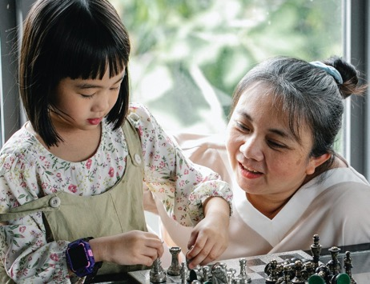

Why it’s Important to Speak Up
Correct Behavior
Chance for adult to correct behavior and allows us to set expectations
Alerts adults that other people are looking out for children’s safety
Opportunity for adult to seek help and support
Notes:
Suggested script:
Trainer’s note: Comment on poll results from the Continuum of Adult Behaviors activity as appropriate with suggested script
In the activity with the polls, all of the behaviors and situations – regardless of prevention level are times we want to speak up. It is critical that we do speak up
One important reason is we’ve talked about that not everyone who violates a boundary is a risk to kids. Maybe the adult made some poor choices but they really want to be a safe adult for children. Speaking up would give them the chance to correct their behavior. It also give us an opportunity to set expectations around behavior.
>ADVANCE SLIDE
And If an adult is putting a child at risk, speaking up also helps alert this person that there are caring adults looking out for this child’s safety.
>ADVANCE SLIDE
Additionally, it can be an opportunity for the adult to seek professional help and find support, or to work towards safer behaviors.
By speaking up and having these difficult conversations we’re addressing child sexual abuse with other adults and encouraging them to adjust any unsafe behaviors they may be engaging in that put a child in a vulnerable situation and increase their risk. Hopefully this allows us to react and intervene potentially before a child is harmed.

Slide 66

Notes:
Suggested script:
We’ve talk about the barriers that keep kids from speaking up. Similarly, there are barriers that keep adults from speaking up too.
Many adults are confident that if they thought a child or teen was being sexually abused, they would speak up. However, in “real life,” there are actually many feelings and other barriers that may cause an adult to hesitate and maybe not speak up at all.

Slide 67

Misinterpreting situation Worried about offending others Make things worse Safety concerns for child Safety concerns for themselves Family disruption Financial loss Embarrassment/Shame and guilt
Barriers to Speaking Up: Fears
Notes:
Suggested script:
When Stop It Now! began, the founder went into prisons and talked to adults incarcerated for sexual abuse. They said that there were plenty of warning signs that a child was at risk, but no one spoke up. These adults said that there were opportunities for other adults to call them out, so to speak, on their behaviors – but no one did.
So, let’s look at what some of these barriers are, starting with fears.
Ask: What are some of the fears that might interfere with someone speaking up? Think about what they might sound like if spoken out loud. For example, maybe a fear is being wrong, so we might hear someone say, “I don’t want to ruin someone’s life over nothing”
Trainer’s note: Prompt participants to include what fears are possible and what they might sound like when someone speaks them out. Collect responses, discussing as appropriate. Then review the bullet points below and as you review the script below, you can also add in some examples of what they sound like, included in script below:
>ADVANCE SLIDE
Fears about speaking up are common and very understandable.
People are worried that they are just thinking the worst, and maybe misinterpreting the situation. They may think they are the only one who is concerned, so they question themselves. For some people, they worry that they may be wrong or that they’re overreacting - and they are afraid to accuse someone of doing something abusive and illegal - and might be ruining their lives.
An example of what this might sound like is, “Maybe it’s just me. I’m probably just misinterpreting the situation”
>ADVANCE SLIDE
Maybe they don’t want to offend anyone. It is often hard to believe child sexual abuse is possible, and so understandably, it is easier to talk yourself out of taking action because of the fear that you would hurt someone’s feelings. Perhaps they that others will wonder how they could even think such a thing and that suspicion will be shifted to them.
An example of what this might sound like is, “I don’t want to hurt my family member’s feelings”.
>ADVANCE SLIDE
Or maybe they worry that talking about it will make things worse - perhaps the person who is abusing a child will somehow punish the child if someone speaks up.
An example of what this might sound like is, “If I say anything, the child may just get abused more”.
>ADVANCE SLIDE
There may also be concerns about safety for the child involved, such as concerns that the person harming the child will become violent.
An example of what this might sound like is, “Talking about it might just make things worse.”
>ADVANCE SLIDE
Or fears about their own safety, such as fearing the family will know who spoke up or made a report and come after them.
An example of what this might sound like is, “I don’t want anything to happen to my family because I’ve said something.”
>ADVANCE SLIDE
Or they may fear that the family or child will experience more trauma, like the family breaking up or someone going to jail. Or they may be wary of social services getting involved.
An example of what this might sound like is, “Talking about this might ruin the family”
>ADVANCE SLIDE
There may be concern that the family will suffer financially, maybe lose their home or a parent will lose their job.
An example of what this might sound like is, “They could lose their home or job if I say anything”
Optional Ask: What kind of family disruption might folks fear could happen if they speak up?
Possible answers for discussion includes: divorce, loss of home, loss of job or community standing, loss of relationships, custody/visitation changes, etc.
>ADVANCE SLIDE
And for some people, it may feel embarrassing to speak up; they don’t know what to say or how to say it. Others may feel shame and guilt, blaming themselves for not seeing what was going on or not acting sooner, and subsequently freeze - never taking action.
Optional discussion questions:
Ask: What might we hear that indicates shame and guilt is the barrier?
Discuss the following, including participants answers and adding what was missed
How could I not have seen what was going on
I should’ve done something sooner
I shouldn’t go outside my family for help

Slide 68

Barriers to Speaking Up: Beliefs
Impossible in theirs or other’s families
They’re a “good” person
Every family has problems
They shouldn’t get involved
They wanted it
That’s how they show affection
They’re “too old”
Nothing will happen anyway
Notes:
Suggested script:
Now let’s look at some beliefs that also can get in the way of adults speaking up and again, maybe some of these are similar to what you noted as barriers for you.
>ADVANCE SLIDE
People often believe that the sexual abuse of a child is impossible in their family and community; it is difficult to think of someone we trust and care about as possibly harming a child. We may deny or minimize warnings signs, disclosures and even their own gut feelings. And folks may believe that they just cannot do anything about child sexual abuse.
Beliefs are influenced by stereotypes. They may prevent a concerned adult from taking action because of the difficulty in believing a “good” person can be sexually inappropriate.
And beliefs are also influenced by cultural attitudes and expectations. Acceptable touch may be different in different families, different cultures.
So let’s review some of these belief generated barriers to speaking up (expand as trainer wants, asking participants if they’ve ever seen any of these beliefs in action):
>ADVANCE SLIDE
So to start and as we’ve said, a barrier is the belief that certain people are incapable of sexually abusing a child because a particular person is considered a good person or maybe because of their role in the community; and perhaps they are a highly respected person. So again, they dismiss any warning signs that they see.
>ADVANCE SLIDE
Some people may believe that every family has problems and thus minimize the issue. This could sound like:
Every family or everyone has problems
• She must have asked for it
• It only happens when he’s drinking
• It’s not that bad
>ADVANCE SLIDE
Sometimes people think they shouldn’t become involved in another family’s business. This is similar to some of the fears we just discussed, but there is also a cultural component about “mind one’s own business” and not getting involved in other’s family life
>ADVANCE SLIDE
Some people think a child or youth being sexually abused - especially an older youth - wanted it or liked the attention.
>ADVANCE SLIDE
And due to having a lack of accurate information, someone could believe that some warning signs are just how the family shows affection.
>ADVANCE SLIDE
Another reason someone may discount a concerning behavior because they believe that person is just too old to sexually abuse children.
Beliefs are often influenced by cultural and societal attitudes and expectations. And relationships can look different in families and cultures, further complicating how situations and behaviors are perceived, so we may deny or minimize warnings signs, disclosures, or even our gut feelings.
But we know that child sexual abuse happens in every type of family, community, culture and region. And we know that anyone can sexually abuse a child.
>ADVANCE SLIDE
A final belief that may be a barrier to someone speaking up or making a report is the belief that if they speak to authorities or make a report to child protective services that it could be dismissed and nothing will happen anyway.

Slide 69

Overcoming Barriers
What helps you overcome barriers?
Notes:
Suggested script:
Reflection: Think for a moment about one of the barriers we mentioned previously that really stands out for you.
Jot down one thing you think may help you overcome this barrier.
Give folks time to complete
Ask: Would anyone like to share (Encourage discussion)

Slide 70

Feeling Prepared
Feeling prepared can help us speak up to another adult about their behavior if the need arises.
Notes:
Suggested script:
Knowing what barriers you might face in speaking up is part of your own personal safety planning, and thinking about the barriers of others – people in your family, families you work with – helps you address your own barriers more productively

Slide 71


We overcome barriers by acknowledging them.
Notes:
Suggested script:
Let’s identify some steps and strategies that have helped adults overcome barriers and feel prepared to speak up.
First, just acknowledging barriers and talking about them can help us overcome them. We need to look at ourselves and identify our own thoughts, feelings, and even biases about sexual abuse and who abuses children.
Fears are real. But if our goal is to protect children, we have to face those fears and do what is in the best interest of the child.
It may be difficult to shift our beliefs and overcome our fears, but we can.
It’s important to be open to learning more about sexual abuse, who causes harm, and confronting barriers that can get in the way of us seeing a risky or harmful situation.
>ADVANCE SLIDE
Some people also find it helpful to remind themselves that keeping a child safe from sexual abuse is worth the discomfort and potential changes in relationships.
And some people find it helpful to reach out to others for support.
The only wrong way to prevent abuse is to not take action when you're having concerns.

Slide 72
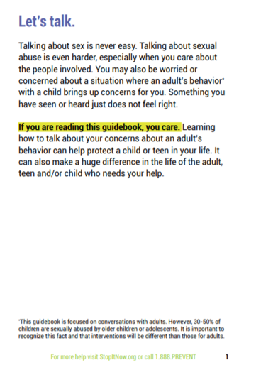
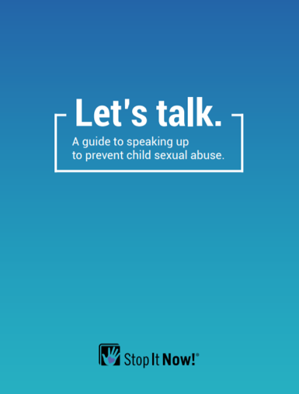
Preparing for Difficult Conversations
ONLY HAVE THIS CONVERSATION IF IT SEEMS SAFE TO DO SO.
Notes:
Suggested script:
Now that you’ve thought about what might get in your way of speaking up, let’s think about how an actual conversation about concerns might go and help prepare you for that.
For some resources to help you prepare, Stop It Now! has a guidebook about speaking up to prevent child sexual abuse, called Let’s Talk in your handouts section.
>ADVANCE SLIDE
And before we get started on how to have the conversation, it is important that you should only have this conversation if you feel it’s safe to do so.
If there is any history of this person engaging in physically abusive behaviors or domestic violence, you should not have this conversation because you don’t know how they may respond, and safety is always the number one priority.
Trust your instinct…if you don’t feel safe, don’t have this conversation, especially not alone.

Slide 73
Communication
Communication is a key prevention tool. Whether you’re being proactive or addressing concerning behaviors.
Notes:
Suggested script:
Let’s review some communication tips and strategies that may help you feel more confident talking about behaviors that concern you.

Slide 74
Communication
Body language and tone
Time and place
Calm, confident, and respectful
Pause and restate things to show you are listening
Tone and Setting
Notes:
Suggested script:
The first thing you want to be aware of is the tone and setting for the conversation. You want someone to feel safe to sit and talk with you, so an angry tone or having the conversation in a room full of people will not facilitate a productive or helpful discussion.
>ADVANCE SLIDE
Be aware of how you’re sitting and your body language: try to be open and relaxed, without your arms crossed for example.
>ADVANCE SLIDE
Be mindful of the place and time for the conversation. It should be somewhere private, and you both should feel unrushed.
>ADVANCE SLIDE
Be calm and speak confidently, and stay respectful even if things get heated or you hear something scary, shocking, or unexpected.
>ADVANCE SLIDE
If you do hear something shocking or unexpected, take a deep breath and re-state what the person just told you. This gives you an extra second to process what they’ve just said and shows the other person you’re listening.

Slide 75
Communication
Avoid labels and intent
Use “I” language
Stick to the facts
Language
Notes:
Suggested script:
The next thing to be aware of is the language you use.
>ADVANCE SLIDE
Avoid labels and derogatory terms (like monster, pervert, pedophile, or abuser) as these will only put up barriers. It closes people off to hearing what you’re saying, and to taking in any information.
You may even want to be clear in saying “this is not an accusation…” or “I really care about you, and this is difficult to talk about…”
>ADVANCE SLIDE
Separate the person from the behavior and use “I” language, like “I feel uncomfortable when I see…”
>ADVANCE SLIDE
And stick to the facts – describe what you witnessed directly or behaviors that were described to you. Don’t assume that you know what someone is intending to do, so saying something like, “it looks like you are trying to abuse my child” will likely only make the other person respond defensively instead of specifically addressing any concerning behaviors.

Slide 76
Communication
“Tune in”
Avoid jumping to conclusions or criticizing
Ask for clarification if needed
Be aware of your own personal triggers
Listening
Notes:
Suggested script:
And even if the conversation is emotionally charged, try to be a good listener.
>ADVANCE SLIDE
Tune into what the other person is saying without planning out your response.
>ADVANCE SLIDE
Try to not jump to any conclusions or criticize the person or their answers.
>ADVANCE SLIDE
And ask for clarification if you need it or if you’re unsure of what the other person is saying.
>ADVANCE SLIDE
Also, know that our own personal triggers can get in the way. Perhaps our own experience with sexual abuse, our own family values, or our own prejudices. Think through what may be a barrier for you and get support if needed. Conversations like these can be difficult, so acknowledging this and preparing beforehand is important for your wellbeing as well as for the success of the conversation.

Slide 77
Communication
Practice what you might say
Anticipate their response and how you might continue
Have resources available
Other Tips
Notes:
Suggested script:
And a few other tips that might be helpful.
>ADVANCE SLIDE
Practice. Planning and rehearsing what you’re going to say beforehand may help you feel more calm and prepared in the moment.
It may be helpful to let someone know you are planning this conversation and have them practice with you, or if appropriate, join you for the conversation.
>ADVANCE SLIDE
Anticipate what the other person's responses might be and how you will respond.
Be prepared for the person to be defensive, angry or upset – remember, stay calm. But also, be aware and if you think the person might become hostile, know your “exit” strategy. Remember, do not have this conversation unless you feel it’s safe to talk with this person. Your safety is a priority.
>ADVANCE SLIDE
Have resources available. This is different for each situation. This may mean knowing what your own program policies are, and knowing whether this is a situation you may have to report if you’re in a youth serving program.
You may want to have some available resources to provide the person if they ask for help or some crisis numbers they can contact for help, especially if you’re worried they may harm themselves or have a history of mental health concerns.
Remember: you don’t need to have all the answers, AND you can always call in professionals who can help you with a conversation or next steps.
And as a reminder, you can always reach out to the Stop It Now! Helpline for support.

Slide 78
Framing the Conversation
Set the tone / share the responsibility to keep kids safe
Be honest and genuine
Describe the behavior
Describe how it made you feel/impact on the child involved
Set boundaries
Notes:
Suggested script:
Let’s look now at having a conversation with an adult about their behaviors. This is a model for having a difficult conversation with adults. Because when we see warning signs – and this means even low level warning signs and even just opportunities to clarify and strengthen safety rules, we need to speak up. This model can set a framework for you that is less threatening and helps the focus remain on behaviors. The goal is not be accusatory. Remember – we actually don’t know intent. What we know are that there are acceptable and unacceptable behaviors, and there are safe and healthy ways of interacting with kids – not so safe ways of being with kids. We want to talk with folks about the behaviors that could create a vulnerable situation for children – not accuse them of being a risk.
Knowing how to frame the conversation around concerning behaviors can be helpful.
So, let’s look at this model (review steps below):
Set the tone and share the importance of everyone being responsible to keep kids safe; highlight a positive way the person shows care for children.
Be honest and genuine; let them know you care and understand this may be a hard conversation.
Describe the behavior that concerns you; focus on the visible behavior and not the intent behind it or the person.
Describe how it made you feel and/or the impact on the child involved; meaning, share how the particular behavior made you feel, and how it may impact the child in a negative way
And….
5. Set boundaries; this is where you want to describe the behaviors you want to see and the expectations you have for behaving around the child or children.
This framework is not a box to lock you in but rather to help you feel more strategic and prepared for a type of conversation of this type. You may ultimately bounce around the different components, maybe even skip one – or any number of other communication difficulties might come up – but this model really can help you stay focused and mission purposed, be clear about the concern and the expectations, and potentially help avoid a more conflictual conversation.

Slide 79
Activity: Low Risk Situations
Your dentist is regularly ½ hour late
Your neighbor’s dog digs holes in your yard
Grandma lets children stay up past bedtime
Your roommate always leaves a mess
Your food has arrived cold at a fancy restaurant
Notes:
Suggested script:
Activity: Low Risk roleplays
Instructions: Break participants into ideally groups of 3, so that everyone will play the role of person speaking up, person receiving the feedback, and an observer. Pairs can be done as well, if needed due to group size.
Handout: Role Plays: Low Risk Situations
Suggested Language to explain activity:
Inform participants that they are going to get an opportunity to practice speaking up in low-risk situations, in ordinary and everyday situations that do not involve child sexual abuse.
Explain that they may not all think that some of these situations are low-risk, as different speaking situations raise different fears and anxieties. However, these situations are not as related to safety as child sexual abuse prevention. Rather, these may be “ordinary situations” that sometimes challenge us for personal reasons. Trainer can share personal fear (i.e. fear of speaking up, fear of returning food in restaurant, fear of waking someone up, etc.). You can include invitation for participants to use the examples provided but that they are welcome to practice any real life examples as well.
Ask them to role play talking with someone about one of the low-risk situations, practicing the listening skills we reviewed and keeping in mind what we’ve learned about focusing on behavior and not intent, and the framework just introduced to them.
State that the goal is for each person in a triad is able to practice each role, and review these additional role play preparation notes:
Decide for each scenario, who is the person concerned, who is the person with the concerning behavior and who is the observer/coach
Share that some people find it easier to talk out what the conversation will look like. Not everyone likes to role play – understandable, but it is a great learning tool and so encourage yourself to try it.
Everyone’s role is important. If there is a 3rd person, this person acts as the “observer/coach” and has a critical role to help everyone assess how it is going, acknowledge the strengths and share what could be made stronger. The observer is supportive, offering helpful feedback and new perspectives – they are not a critics.
The person whose behavior is concerning should be (at first) open to the conversation and can determine whether giving a little push back is appropriate…we don’t want to make it too easy – or too hard, but providing a little disagreement is a great way to practice in the save container you’re building to practice these conversations.
Based on the size of the groupings, allow about 5 minutes per scenario, encouraging each group member to practice each role, and then debrief when the whole group is pulled back together.
Debrief: Ask for comments, experience thoughts and/or revelations?
Optional questions for debrief:
How did that feel?
What role felt easier? Harder?
How do you think you did in your role?
Were there any insights you had about how to communicate more effectively about boundaries, behaviors, etc?

Slide 80
Practice Speaking Up
You’ve noticed an adult family friend is behaving in an unsafe or inappropriate way with your child, for example you’ve seen them whisper and ask your child to keep a secret.
Set the tone / responsibility | “I know we both want the best for the kids. It’s important for both of us that our children feel and stay safe.”
Be honest and genuine | “I feel uncomfortable bringing this up but it’s important to me and I’m sure it’s important to you as well.”
Describe the behavior | “I notice you often whisper to Lee, and I’ve heard you mention to them to remember to keep the secret.”
Describe how it made you feel/impact on the child involved | “That makes me feel uncomfortable, and it sets an unsafe precedent for Lee around how adults should treat and interact with them. If they think it’s okay to keep secrets, they may not understand that potentially puts them at risk.”
Set boundaries
Notes:
Suggested script:
Let’s look at an example that is more pertinent to children’s sexual safety.
You’ve noticed an adult family friend is behaving in an unsafe or inappropriate way with your child, for example you’ve seen them whisper and ask your child to keep a secret.
So first, setting the tone, you might say:
“I know we both want the best for the kids. It’s important for both of us that children feel and stay safe.”
If you can, highlight a positive way they show care for children, for example, let them know you are grateful they care for your kids and spend time with them.
Next you want to be honest and genuine so you might say:
"I feel uncomfortable bringing this up but it’s important to me and I’m sure it’s important to you as well."
And then you want to describe the behavior, such as:
"I notice you often whisper to Lee, and I’ve heard you mention to them to remember to keep the secret.”
Next, share how that particular behavior made you feel, and the impact on the child involved so something like:
“That makes me feel uncomfortable, and it sets an unsafe precedent for Lee around how adults should treat and interact with them. If they think it’s okay to keep secrets, they may not understand that potentially puts them at risk.”
And finally, you want to set boundaries and describe the behaviors you want to see.
Ask: Let’s practice that one…Take a moment and write out how you would approach this particular part of the conversation.
Would anyone like to share? Or pop it into chat?

Slide 81
Practice Speaking Up
You’ve noticed an adult family friend is behaving in an unsafe or inappropriate way with your child, for example you’ve seen them whisper and ask your child to keep a secret.
Set the tone / responsibility | “I know we both want the best for the kids. It’s important for both of us that our children feel and stay safe.”
Be honest and genuine | “I feel uncomfortable bringing this up but it’s important to me and I’m sure it’s important to you as well.”
Describe the behavior | “I notice you often whisper to Lee, and I’ve heard you mention to them to remember to keep the secret.”
Describe how it made you feel/impact on the child involved | “That makes me feel uncomfortable, and it sets an unsafe precedent for Lee around how adults should treat and interact with them. If they think it’s okay to keep secrets, they may not understand that potentially puts them at risk.”
Set boundaries | “I want you to follow our family’s rules and guidelines and stop whispering or keeping secrets with the kids. Please follow our safety rules going forward.”
Notes:
Suggested script:
Great suggestions and here’s one more example of how you might approach this:
“I want you to follow our family’s rules and guidelines and stop whispering or keeping secrets with the kids. Please follow our safety rules going forward.”
There is no exact right way to set boundaries and expectations, so your words may have been different – and that's okay!
But do notice that we’re not accusing them of acting in a harmful way or of grooming Lee, we’re instead identifying a behavior that may be on your family safety plan, is out of the ordinary, or is potentially unsafe.

Slide 82
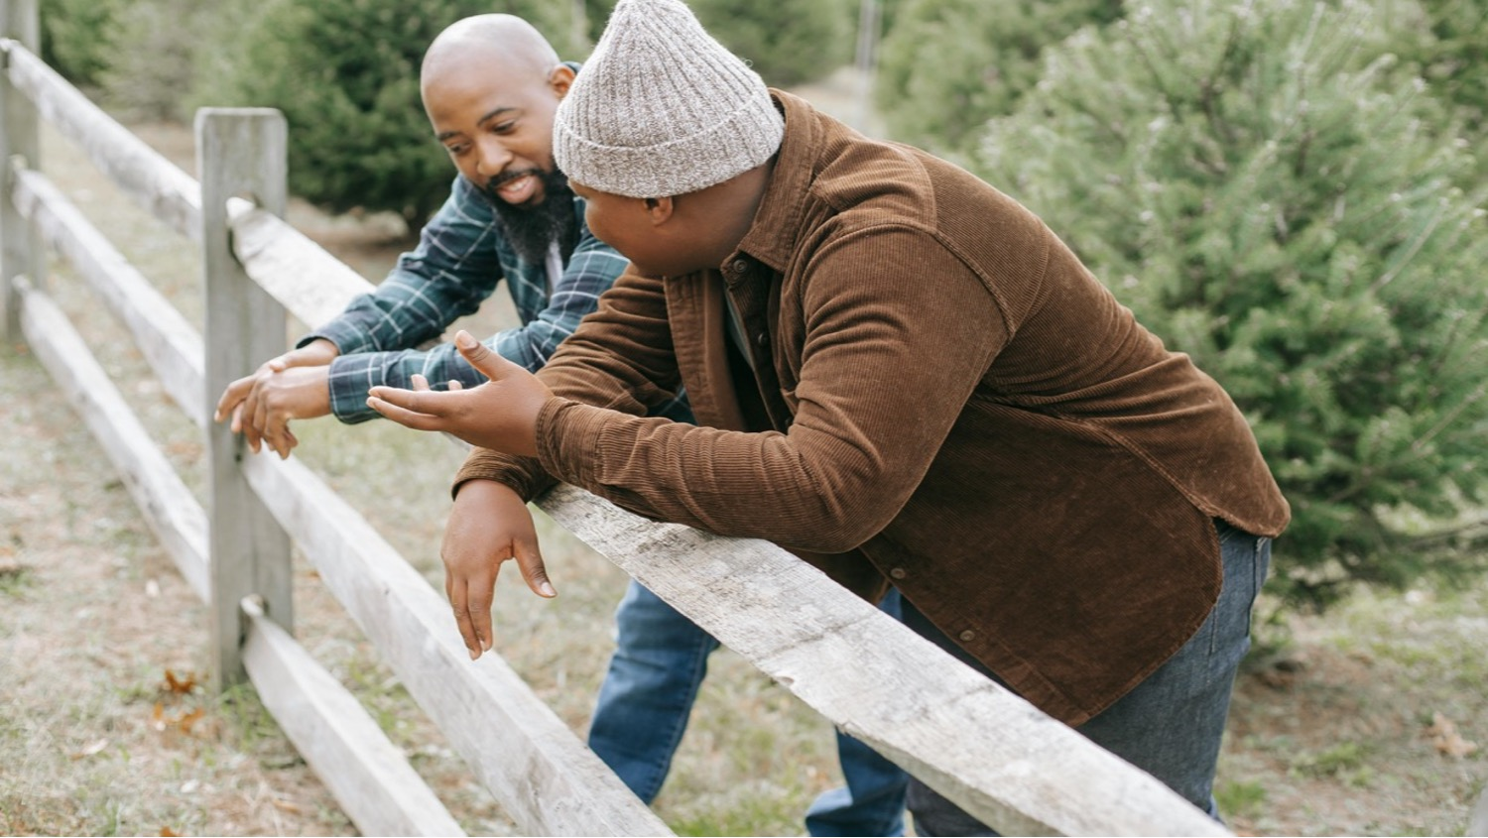
Practice Speaking Up
Notes:
Suggested script:
Finally, you may want to check-in with the person you spoke with after you’ve given them a little time to digest what you were saying to them, and asking of them as well.
And remember that this isn’t all-or-nothing. You may end up having two, three or four conversations – it’s a process. And it may feel awkward using this framework at first.
Don’t worry if you don’t get it perfect. These are just guidelines to help you prepare you. Remember: each step you take is meaningful.

Slide 83

Helpful tips and reminders:
Focus on observed behaviors vs intent
Speaking up is proactively keeping children safe
Demonstrating that a child is supervised helps protect them
It’s okay to be nervous; you don’t have to be perfect
It may be helpful to write down what you want to say
Honor your own feelings and take care of yourself, seek support when needed
Follow up!
Notes:
Optional
Suggested script:
Hopefully, that activity was helpful in preparing you to think through how you might frame a difficult conversation when you see concerning behaviors or warning signs.
Let’s review some final tips and reminders that may be helpful.
>ADVANCE SLIDE
When we focus on observed behavior instead of intent, we can then talk exclusively about the behavior that was observed without blame, accusations or allegations. This can make a potentially difficult conversation less charged.
>ADVANCE SLIDE
By speaking up and setting boundaries, we are proactively keeping youth safe safe. We are telling other adults what behaviors are ok and not ok around children.
>ADVANCE SLIDE
We are also telling other adults that this child has caring adults in their life is being supervised. We’re letting others know that this child is protected which makes it more likely that an adult does have harmful intentions will leave this child alone.
>ADVANCE SLIDE
It’s ok to be nervous – the conversation doesn’t have to perfect.
>ADVANCE SLIDE
Some people find it helpful to write down what they want to say.
>ADVANCE SLIDE
Honor your own feelings and take care of yourself. If the conversation gets emotional, it’s ok to say, “hey, I see that this conversation is getting heated, let’s take a break?”
Make sure you have support, and again - never feel like you have to have this type of conversation if the situation doesn’t feel safe.
>ADVANCE SLIDE
Finally, follow up check in after the conversation, and provide any resources you promised. And follow up with your own safety planning – ensuring your safety rules and environment are protecting children.
And, if you feel that the concerning behavior continues to happen – involve others to reinforce the rules and boundaries or plan next steps that might be needed to protect the child or children. This may involve limiting contact of this adult with children, and thinking about overall environmental safety as well.

Slide 84

Activity: Adults Crossing Boundaries
Set the tone - shared responsibility and accountability
Describe the behavior
State what you want
Speak up and set boundaries
Notes:
Suggested script:
Now let’s do some more role plays…with more relevant content, looking at scenarios where there are warning signs. First, let’s watch a role play between Now! staff to help demonstrate a conversation between two people, when one person is concerned about another person’s behaviors. We are going to watch two versions – the first one has a slightly more agreeable tone, while the second one provides us with an example of a conversation that can be more difficult due to the response of the person whose behaviors are concerning.
Role play video to play for participants: https://youtu.be/YJGD4VTWTls
Trainer’s note: trainer may also choose to assign watching the video as homework
Ask: Any thoughts, questions, etc. before we move on to practicing this on our own?
Call out examples in the role play that:
Set the tone (noting honest/genuine language)
Described the behavior and the impact on others
Stated the boundaries

Slide 85
Role Play Scenarios
 | PARENTS & FAMILIES | PROFESSIONAL CAREGIVER/EDUCATOR | COMMUNITY MEMBER
1 | Your child tells you your spouse asked them to keep a secret about buying them something. | A parent tells you that your assistant teacher texted their 14-year-old that they are “sexy.” | You have noticed that your neighbor has been standing at the bus stop with a group of children since school started.
2 | You are concerned that your spouse may be looking at illegal images. | A parent in your day camp has been bringing gifts to another camper (not his own child) and asking about the child’s home life. | You’ve noticed a religious leader taking a special interest in a 13-year-old, often bringing them alone to their office.
3 | While visiting for 2 weeks, Aunt Mary tells your 6-year-old that he is going to break lots of hearts and jokes about being younger so she can take a “roll in the hay with him.” | In the teacher’s lounge, you overhear the librarian talking on the phone about an overseas trip, and how cool it was to see so many young, pretty girls “dating” older men. | Your supervisor brings his 9-year-old to work daily after school. A colleague has been spending a lot of time with her. You observed him telling her that her dad doesn’t understand her the way he does, and he has been talking about dating websites he visits.
Notes:
Suggested script:
Ok, your turn….
Activity:
Instructions: Split participants into groups of 3 if possible. Ask them to take out their two handouts – Role Plays: Adults Crossing Boundaries and Sample Scripts for Role Plays. They can use the first handout to pick which role play they’d like to start with, and the second one if they’re having trouble thinking of ways to have this conversation (as it models some sample talking tips). Have each person choose their role (or assign them if needed) as the observer, adult crossing boundaries, and person bringing up the concerns. Then, have each participant switch when done. Have everyone be in each role, and have each group take the time to reflect/give suggestions/constructive criticism.
Sample language for introducing activity: We’re going to practice having these difficult conversations now. These scenarios are chances to practice talking with another adult about their behaviors – not their intent, but their behaviors. There are 3 different type of relationships scenarios to choose from – with a family member, with a professional and with a member in your community (such as in your neighborhood, in a faith based setting and in an office). You can also make up your own! But in the role plays you’re going to practice, each of you should have a chance to be in all the 3 roles: observer, adult who has crossed a boundary/with warning signs, and the adult raising the concern and identifying the behavior. We’re not practicing having a confrontation or making an accusation, but instead are looking to let another adult know that their behaviors are increasing the risk for children. Although – don’t make it easy for each other – you’re welcome to give a little push back. Your handouts will help you: the first gives you the role play choices, the second helps you with sample scripted language you can use or modify if you’re having trouble thinking of how to have this talk.
Suggested time: minimum of 15 minutes, giving 5 minute reminders to encourage participants to change roles/scenarios
Handouts:
Role Plays: Adults Crossing Boundaries
Sample Scripts for Role Plays
(debrief is on next slide)

Slide 86
Role Play Debrief
What was challenging to talk about?
What did you notice about switching roles? How did it change your perspective? How was it to observe?
What skills came naturally?
What skills did you notice need strengthening?
What else??
Notes:
Suggested script:
Debrief: Once group is back together, ask for volunteers to discuss the experience using the questions above to facilitate conversation

Slide 87

Wrap Up
Notes:
Suggested script:
We have come to the end and want to thank you all so much for your engagement and the work you do to keep children and families safe.
Trainer’s note:
Suggested final check out questions if time allows
What do you need now?
What do you plan on doing now?
How can we support you?
We acknowledge that the conversations and information shared may have been difficult at times. That is understandable, and as always, we encourage you to seek out support in however that makes sense for you – but please do practice self-care; pay attention to how this course has impacted you. You do not need to know everything! In fact, we are stronger when we ask for support, support each other and work together…we know we all want the same thing – to keep children safe from harm.
And as always, reach out…we’re here for you.
Handout: Resources for Support, Information and Guidance – for Parents and Youth – these are crisis helplines, hotlines and numbers for a variety of situations for youth and adults

Slide 88
Thank you!
stopitnow.org
facebook.com/StopItNow
Helpline: 1.888.PREVENT
Notes:
Suggested script:
Handout post-survey

